Slide 1
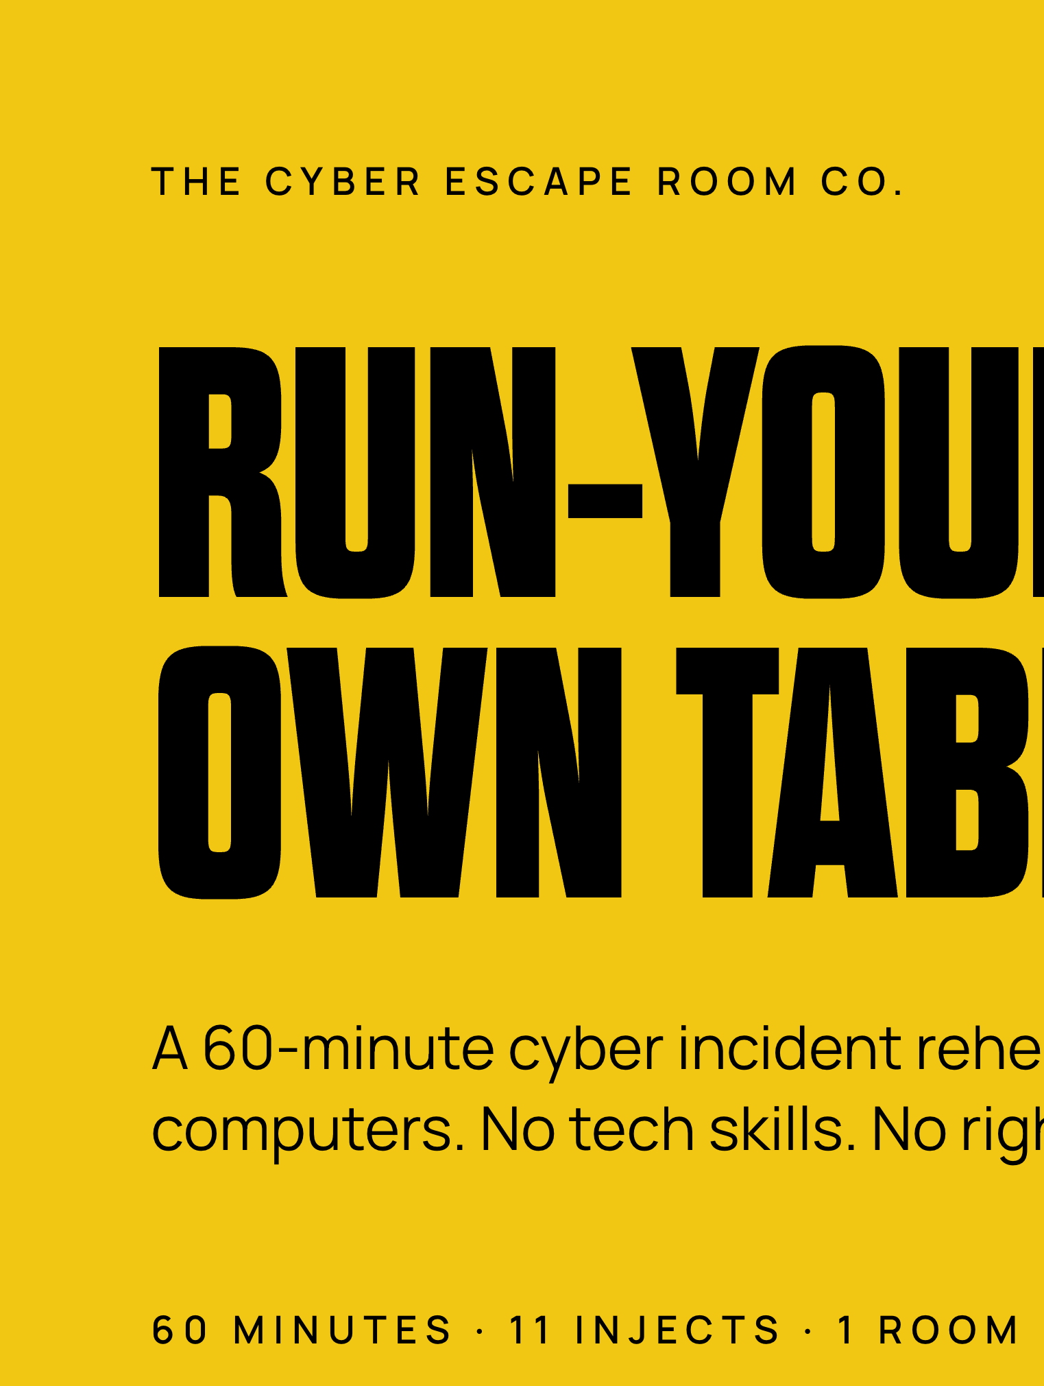


Notes:
Hold here while people sit down. Say nothing clever. One line: we are going to spend an hour finding out what we would actually do.

Slide 2
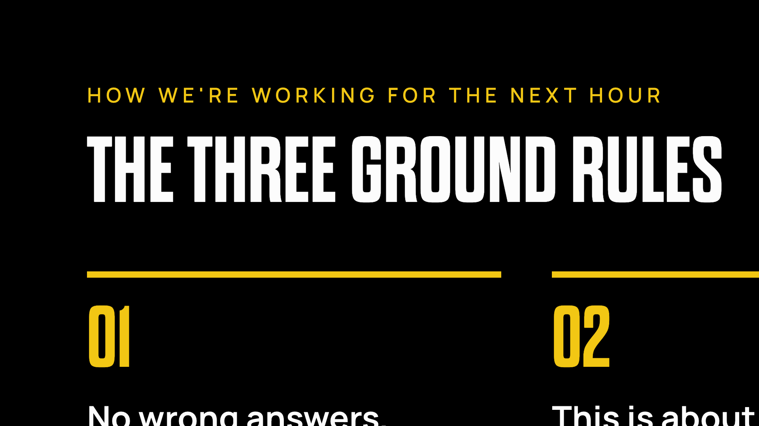
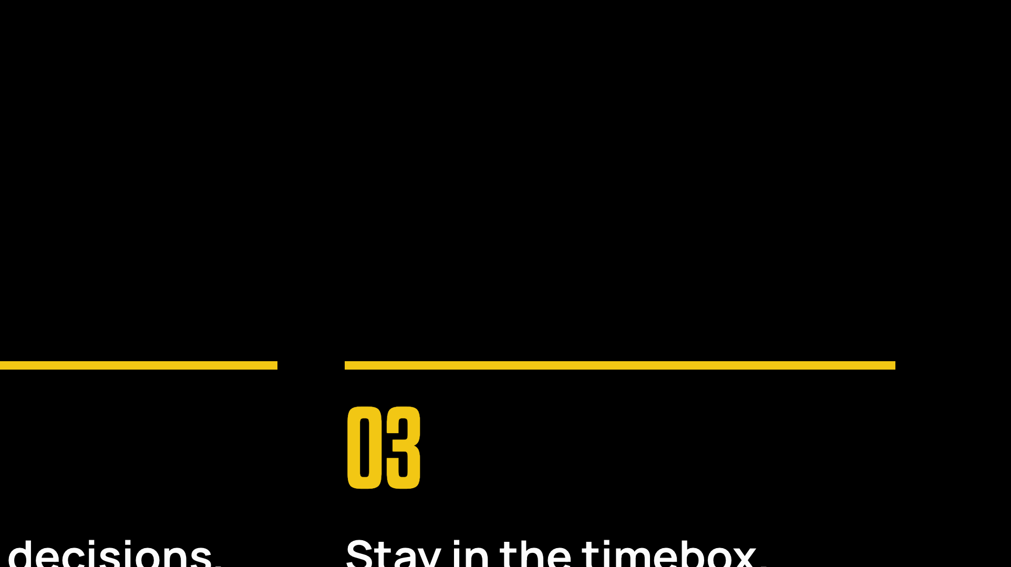
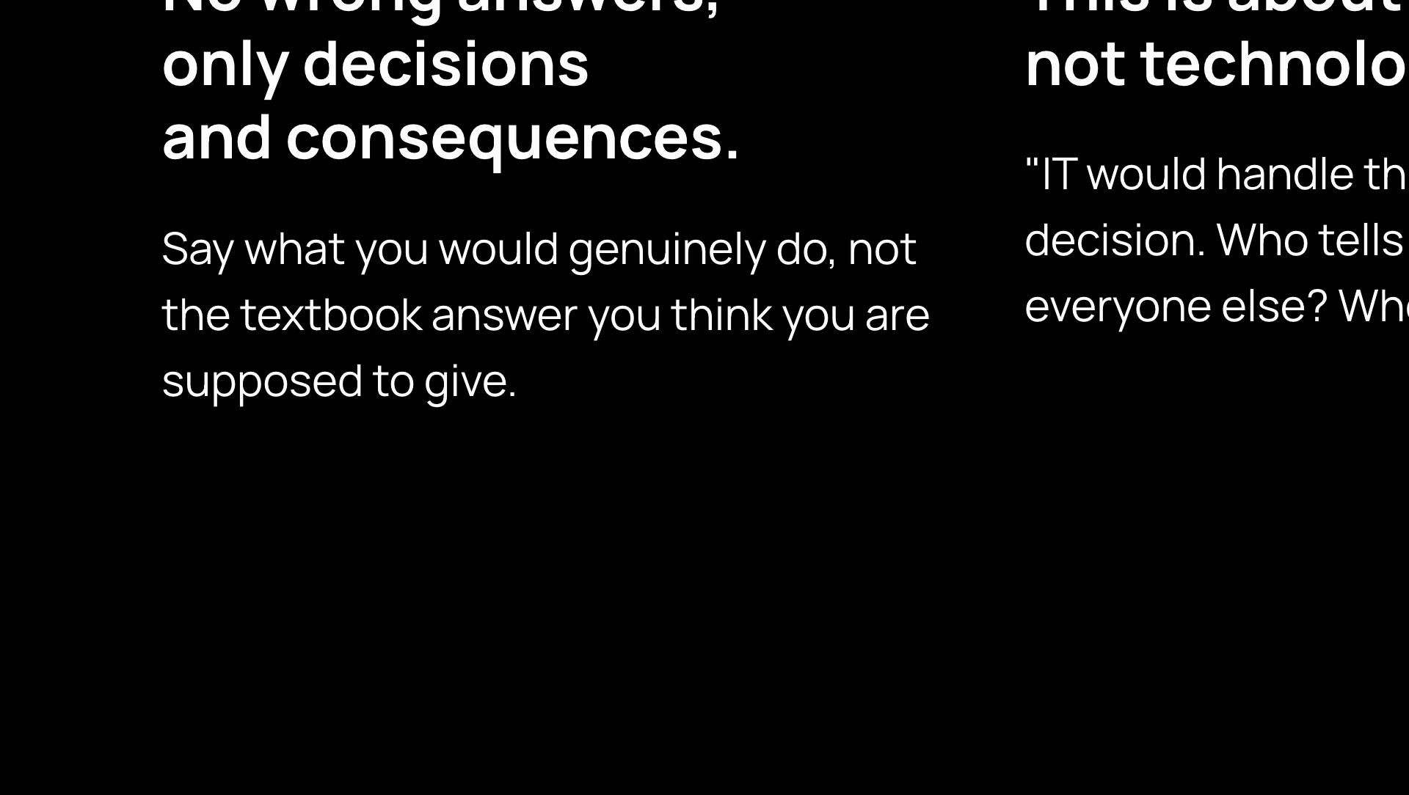
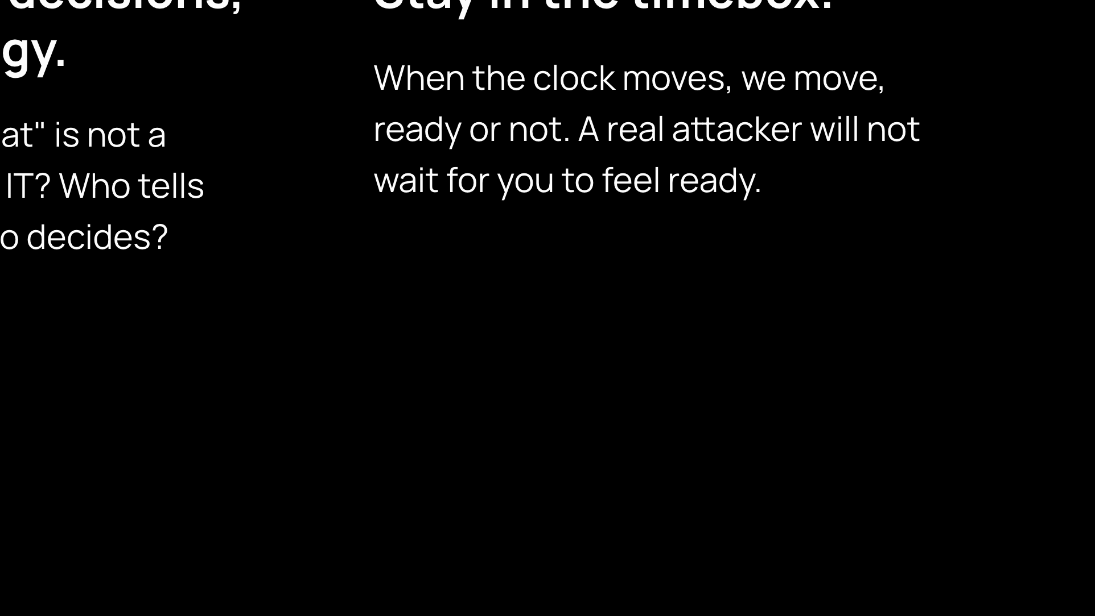
Notes:
Read all three aloud, verbatim. Then add the fourth for yourself: make it safe to be honest. Someone admitting they would not have known who to call is a win, not an embarrassment.

Slide 3
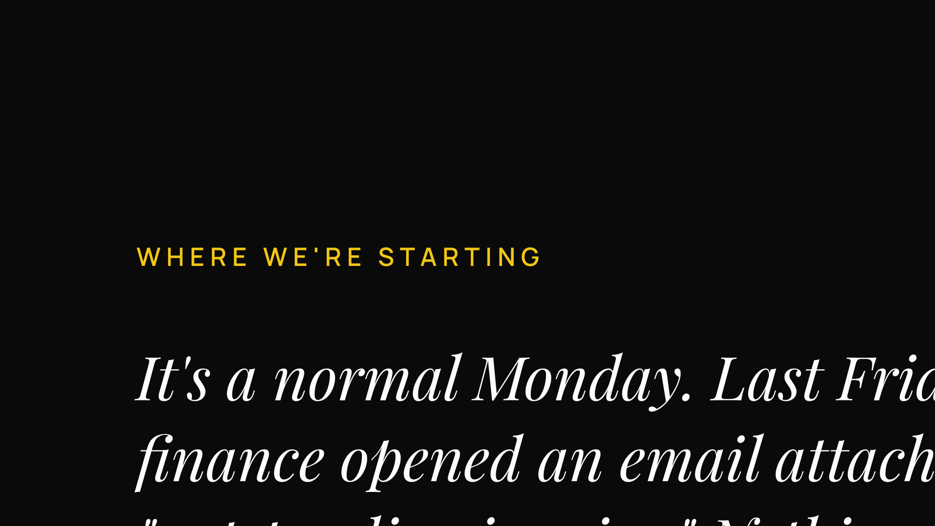
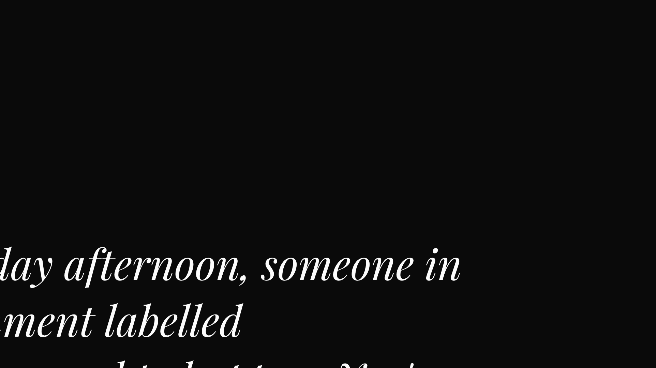
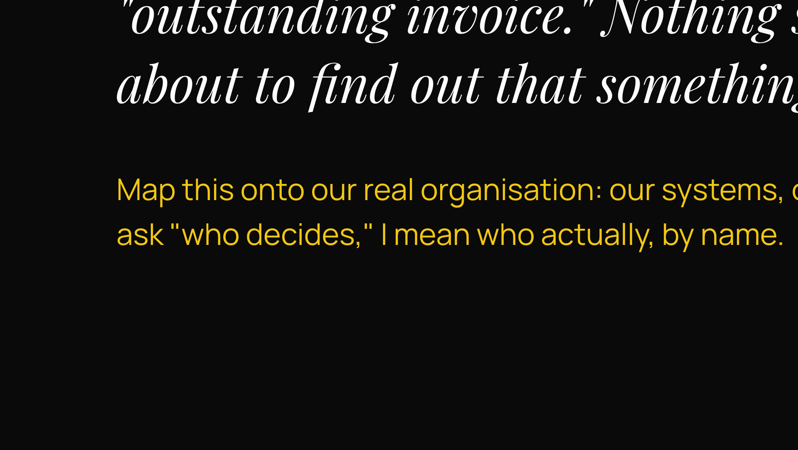
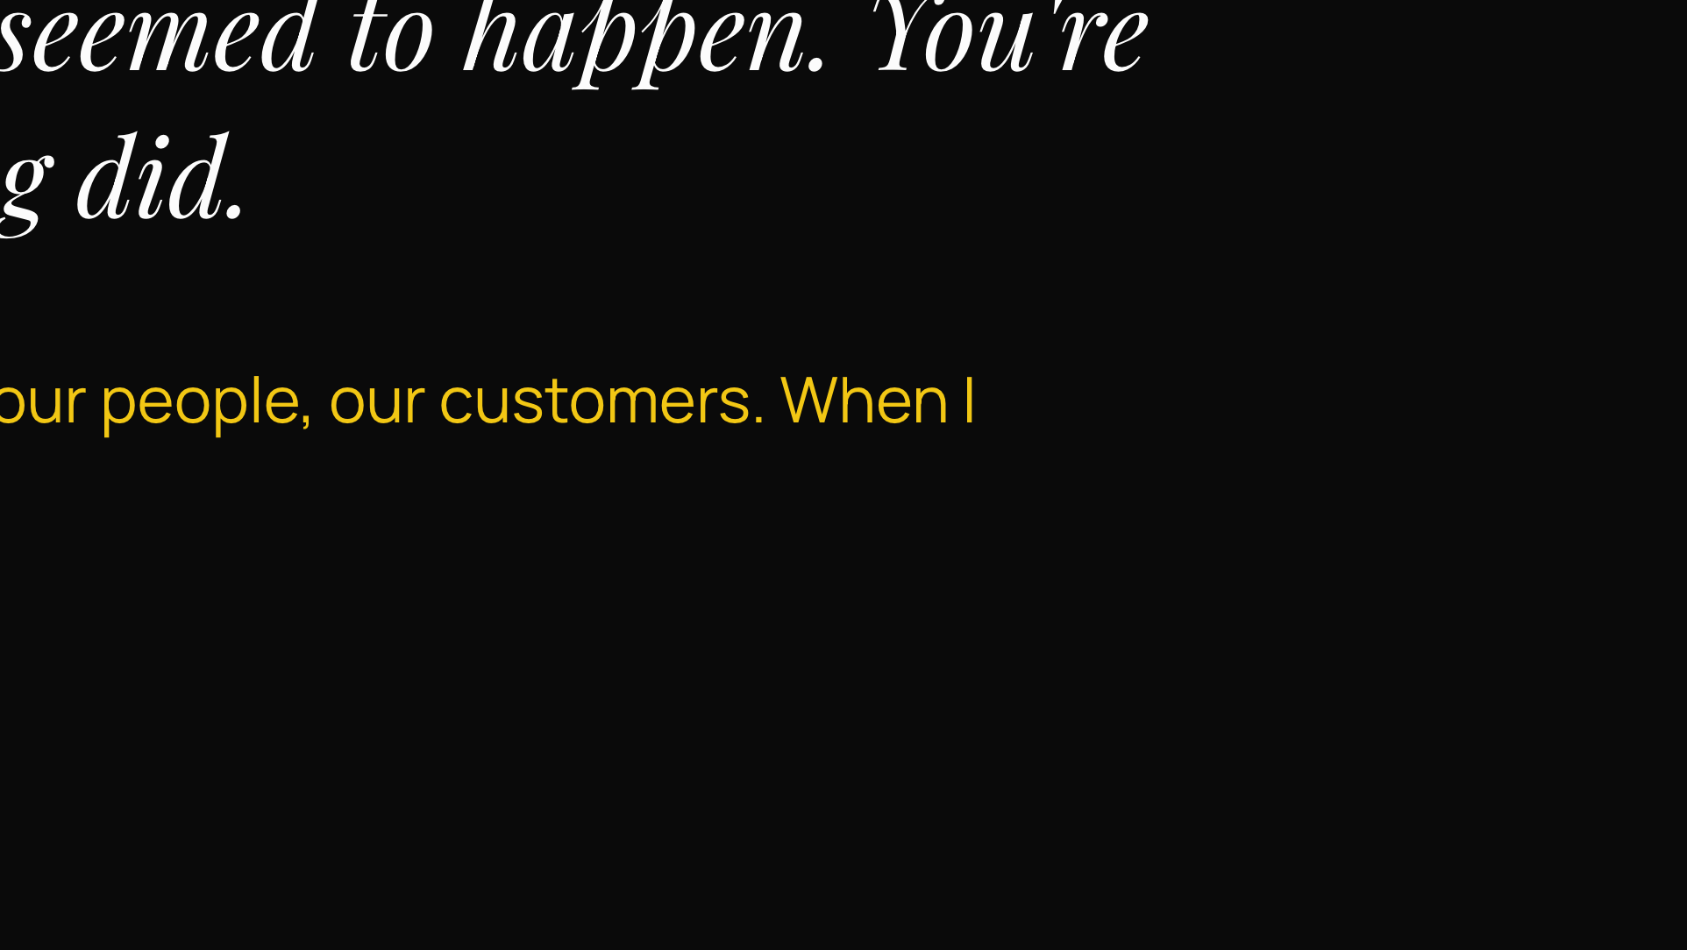
Notes:
Read the brief aloud slowly. Then ask the room to picture our own systems, our own people, our own customers. Set the expectation now that who decides means a name.

Slide 4
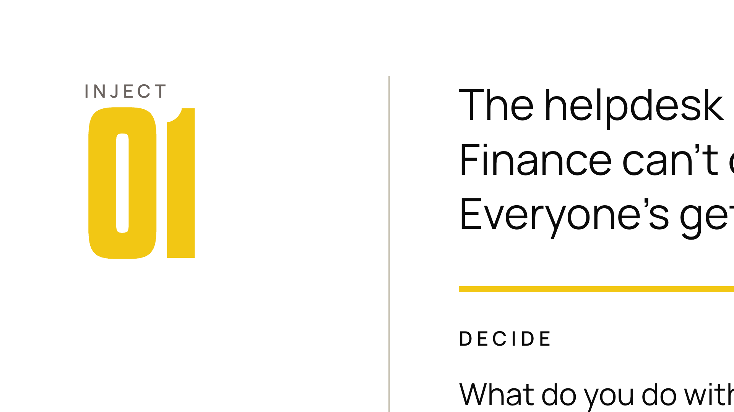
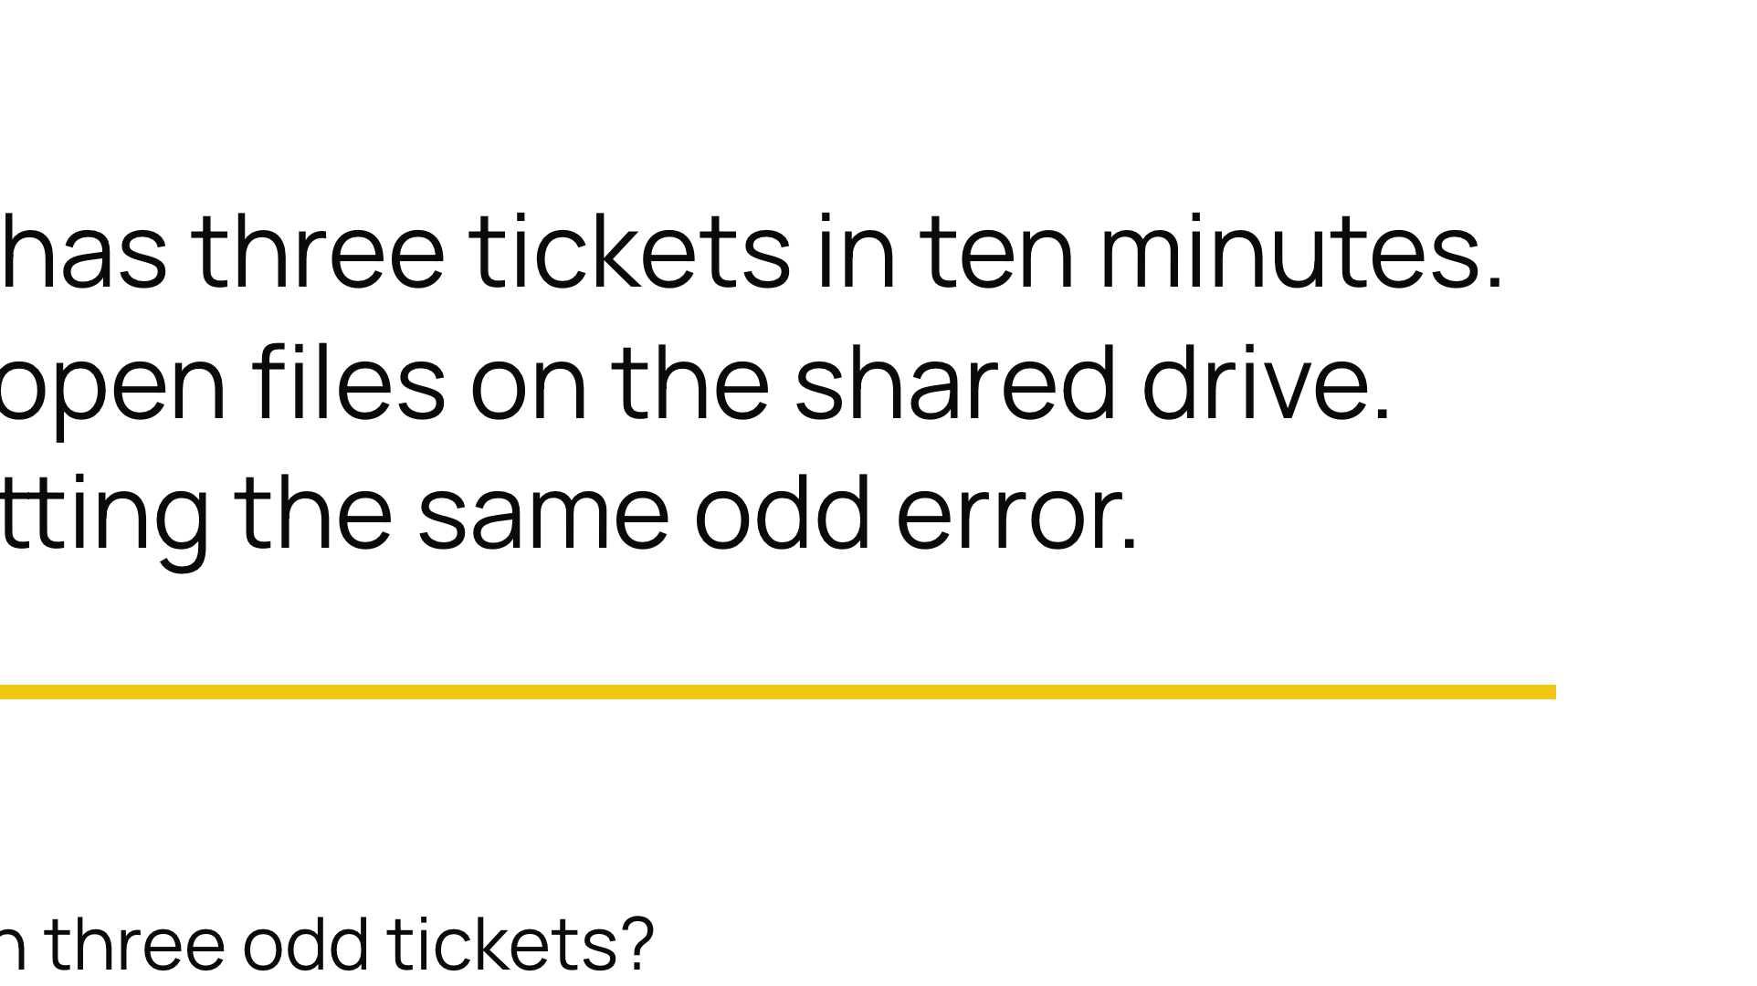
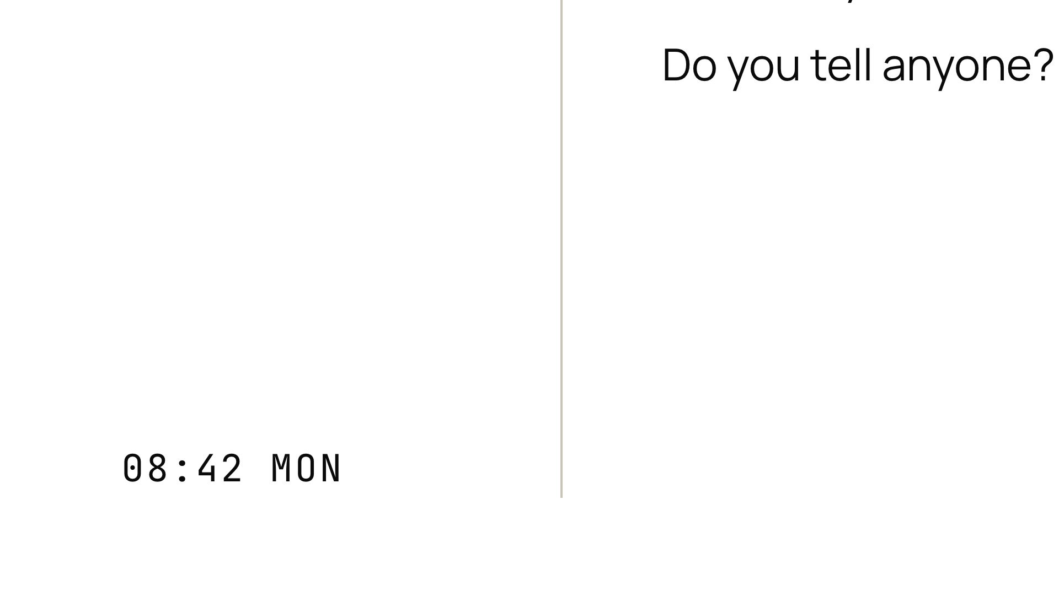

Notes:
Watch whether they treat it as background IT noise or as a signal. Almost every real incident starts life as probably nothing.

Slide 5
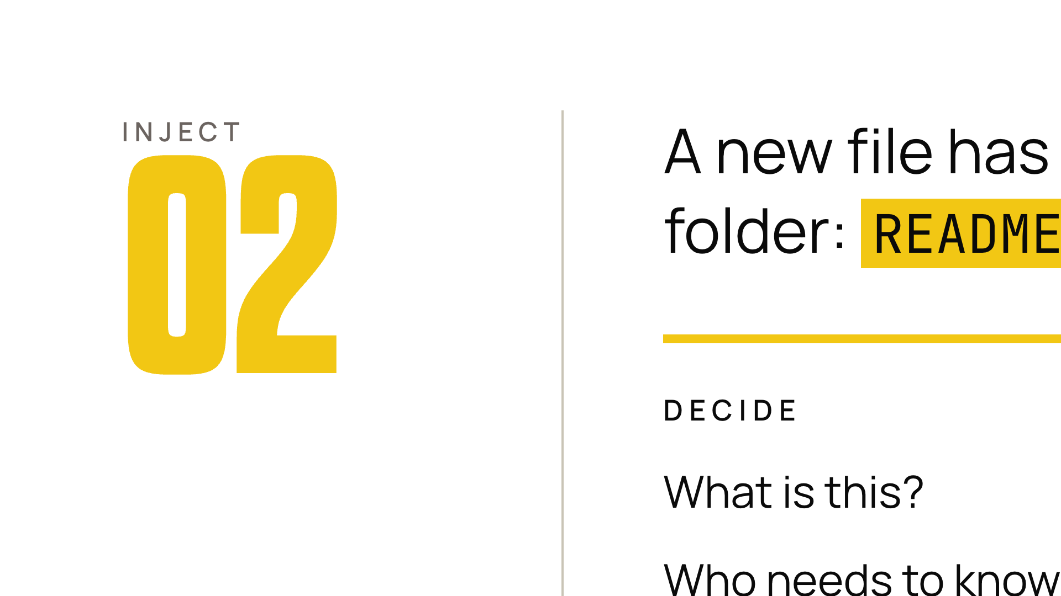
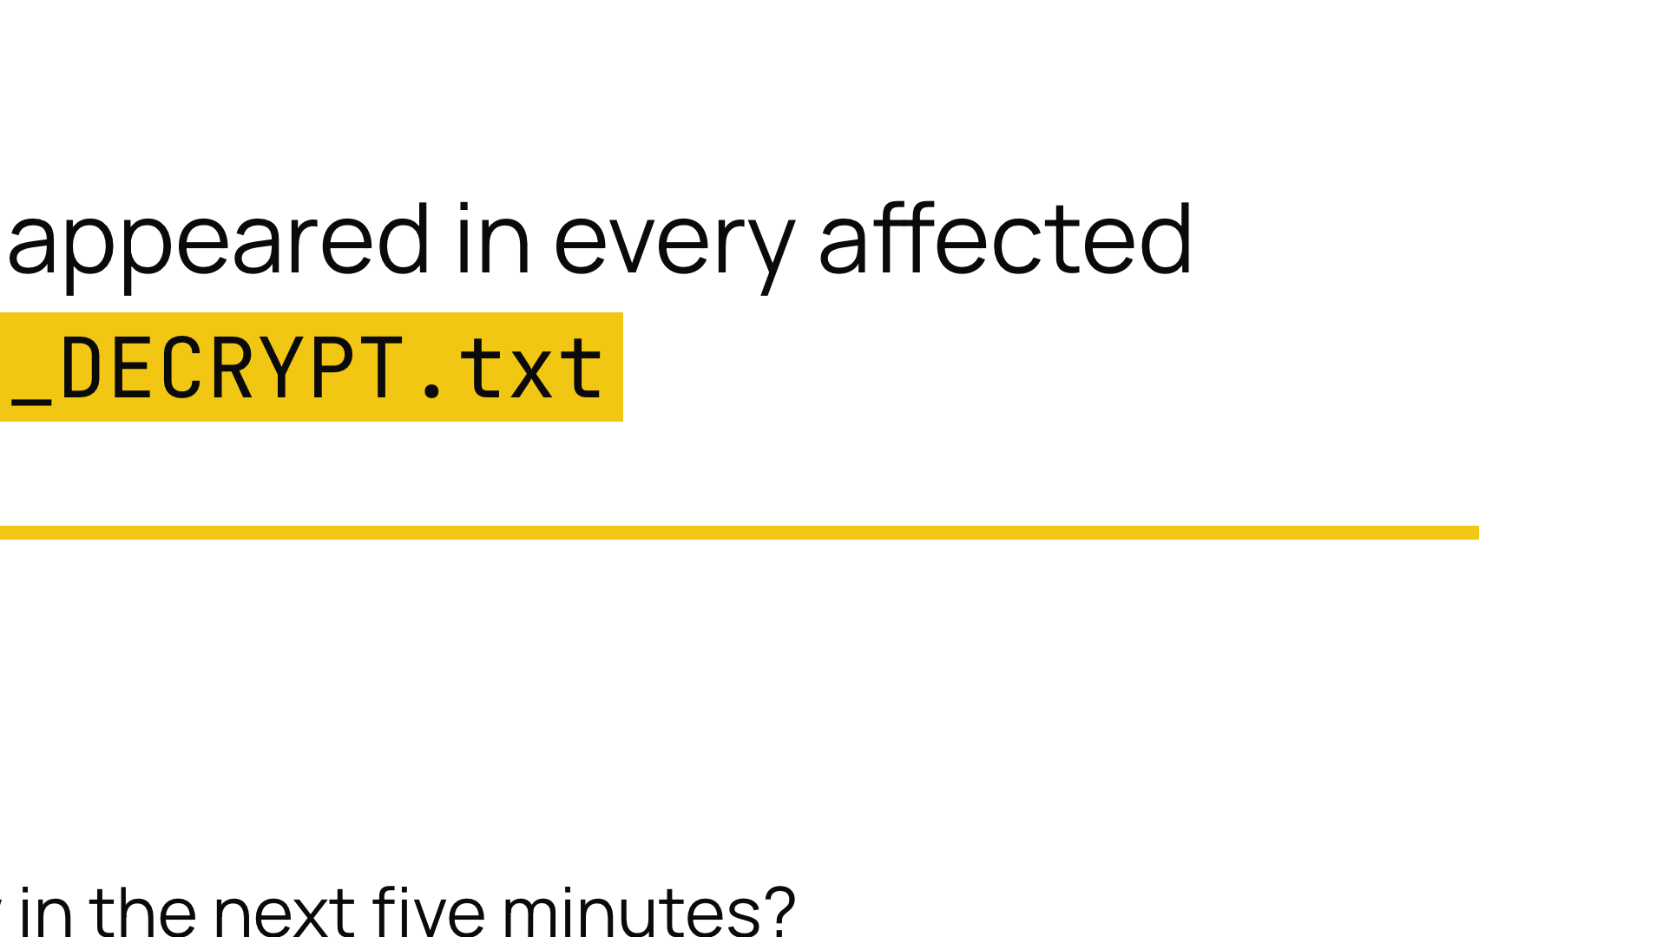


Notes:
This is the moment probably nothing becomes oh no. Note how quickly the room escalates.

Slide 6
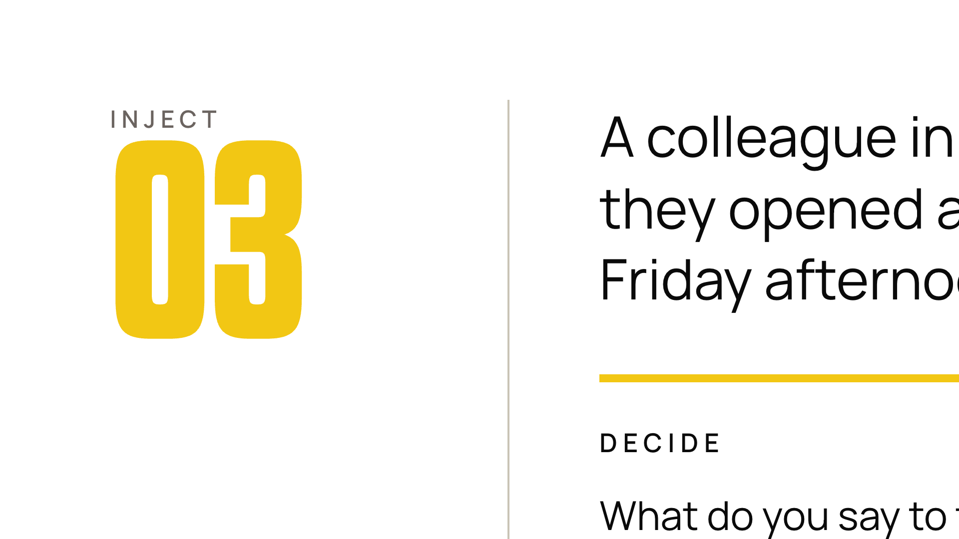
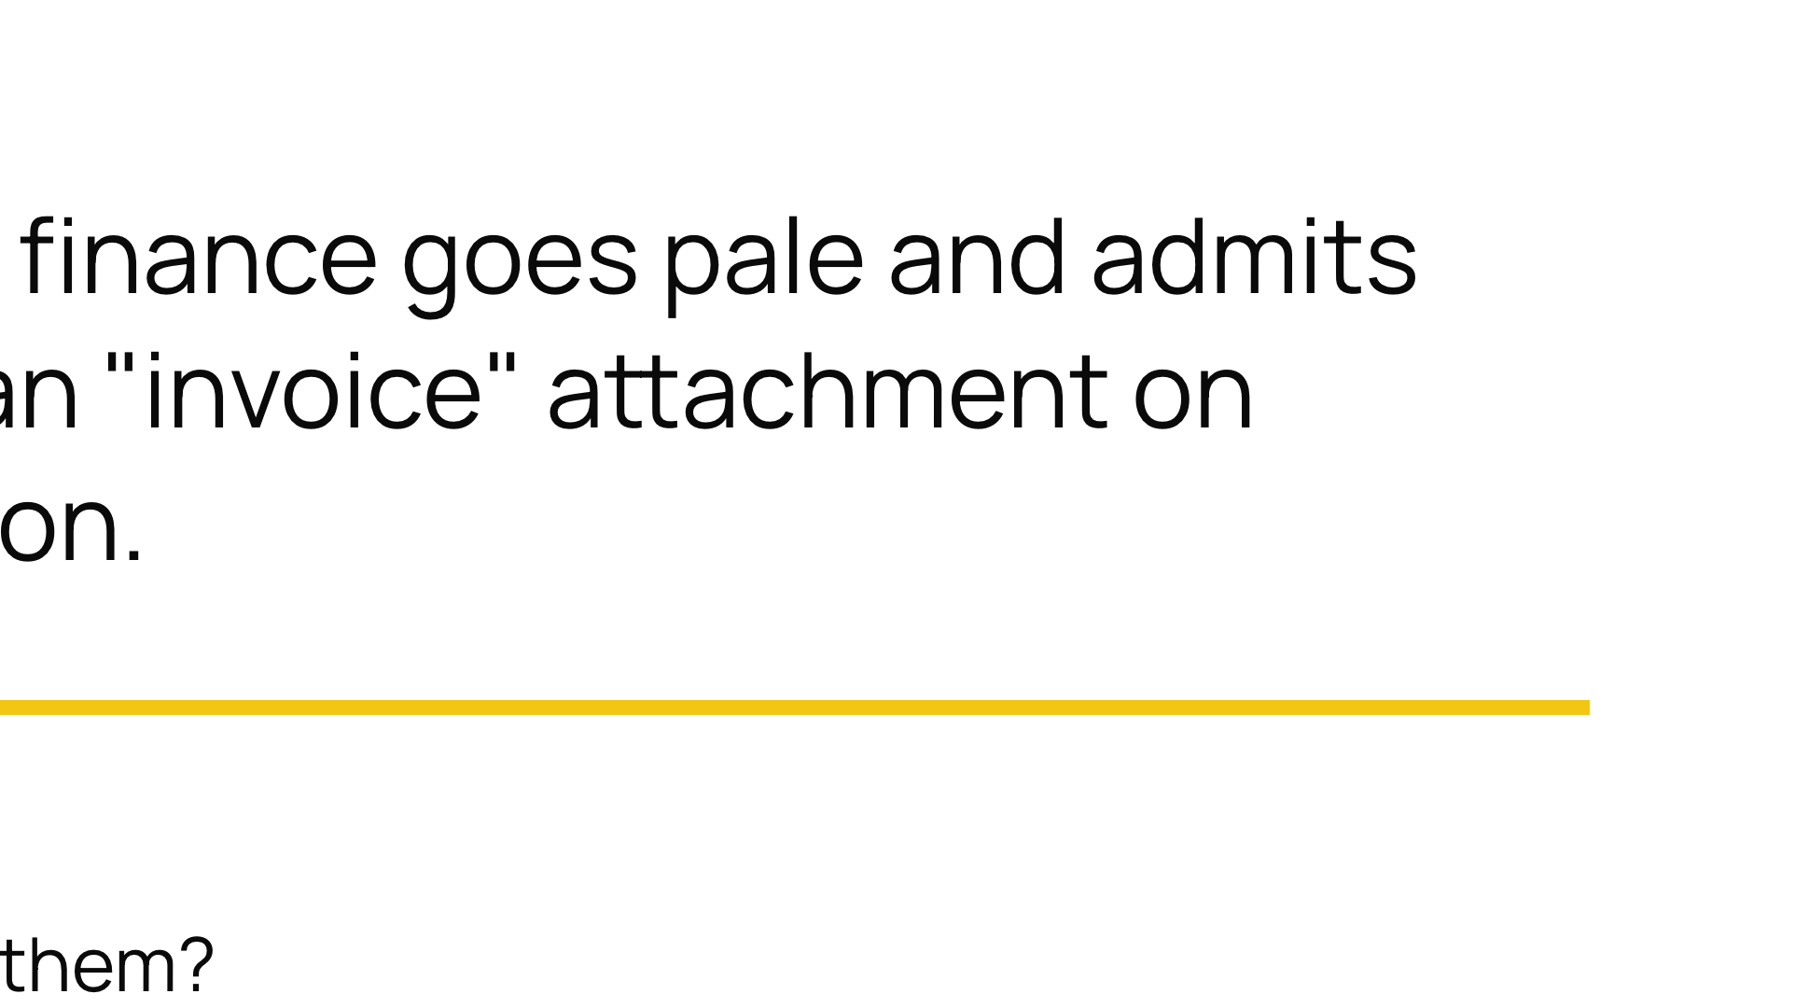
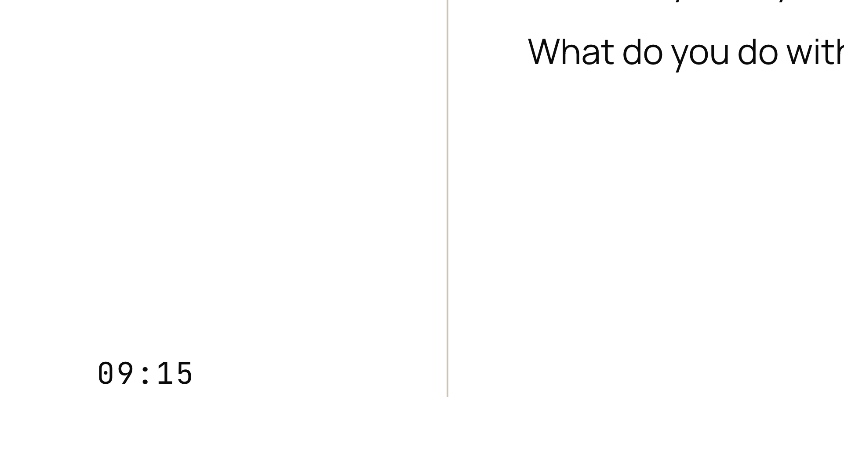
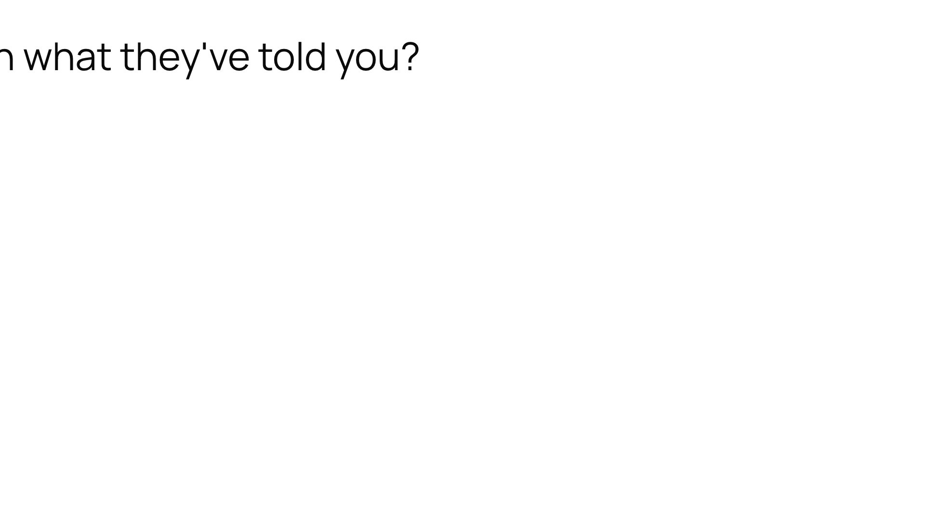
Notes:
If the room's first instinct is blame, flag it in the debrief. Blame is exactly why the next person will not own up fast enough.

Slide 7
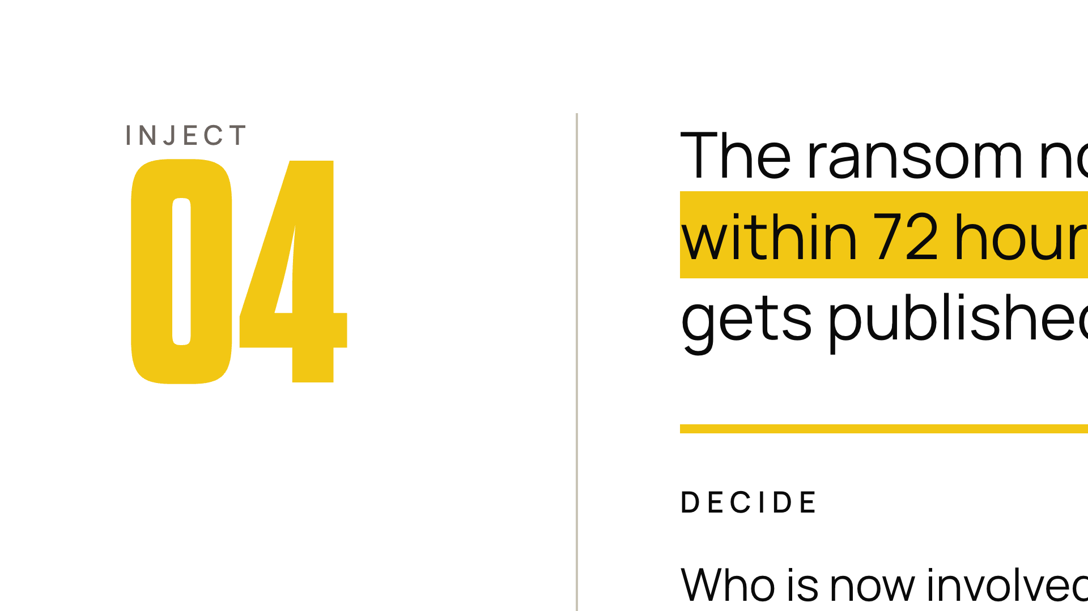
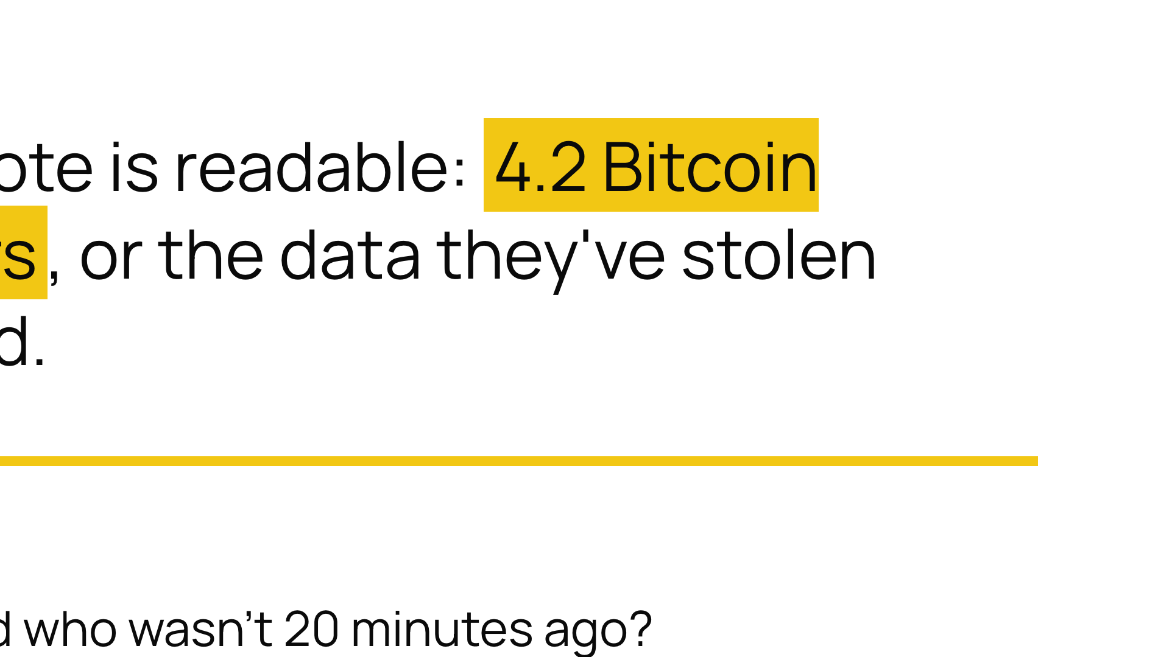
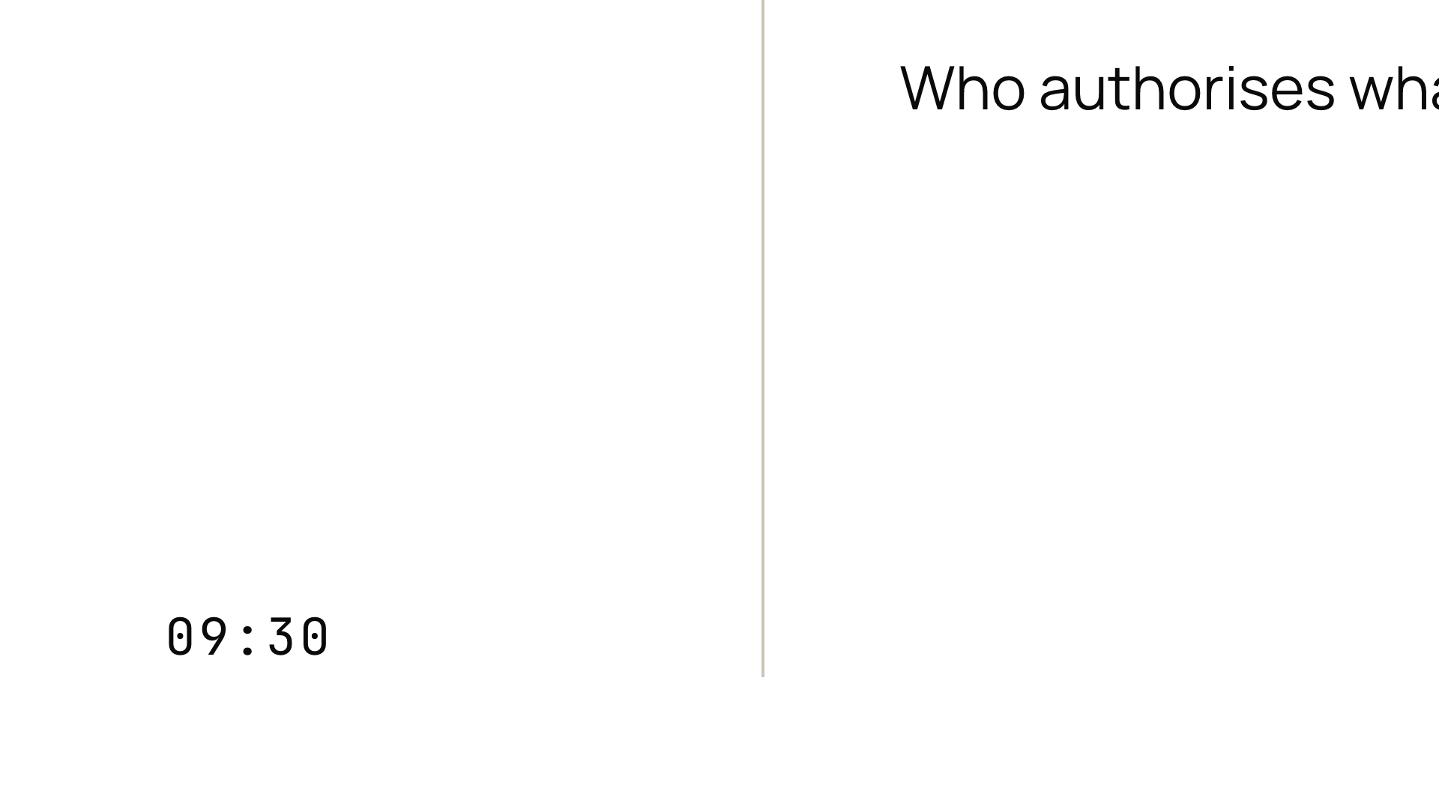
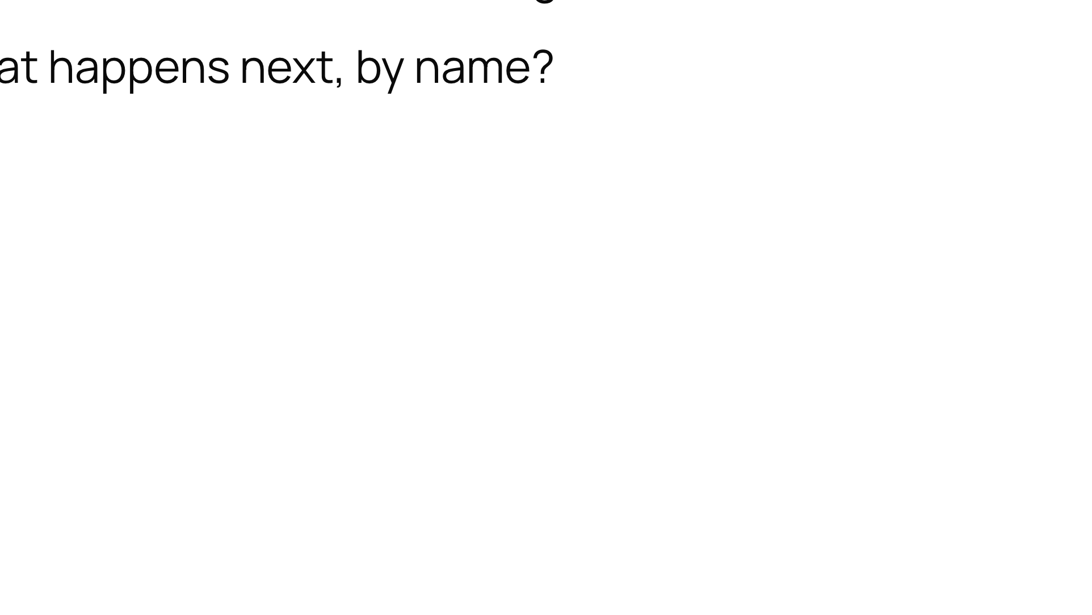
Notes:
Push for actual names and roles, not management or the business.

Slide 8
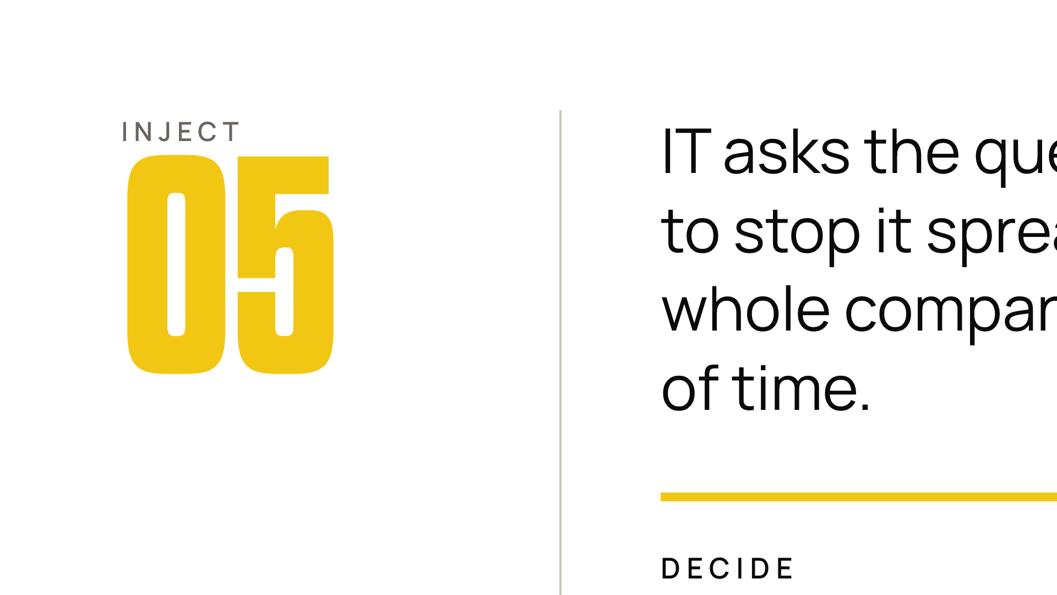
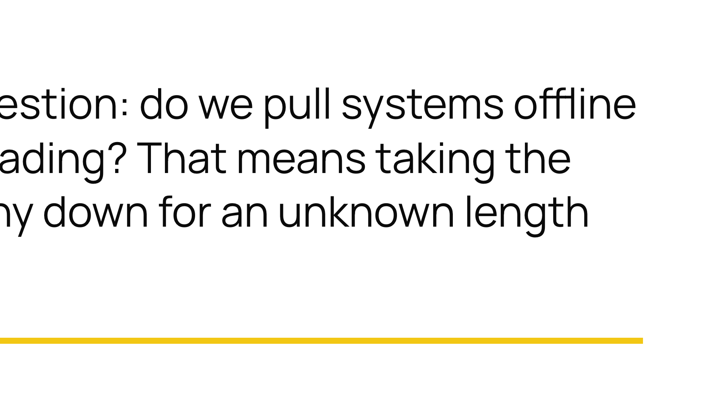
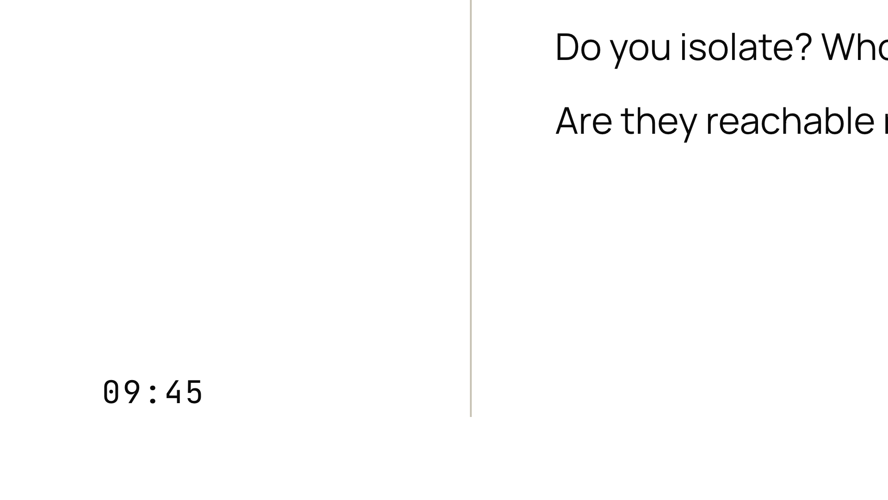
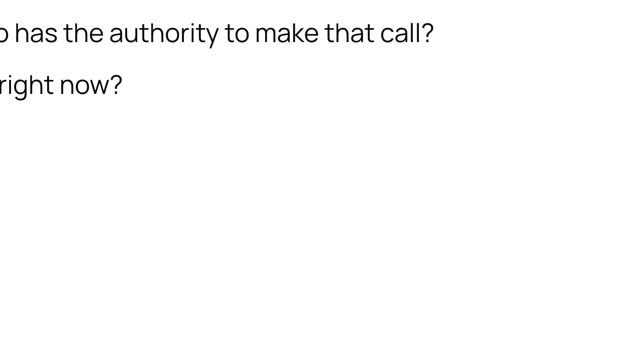
Notes:
The real question hiding here is: do we even know who is allowed to make this decision?

Slide 9
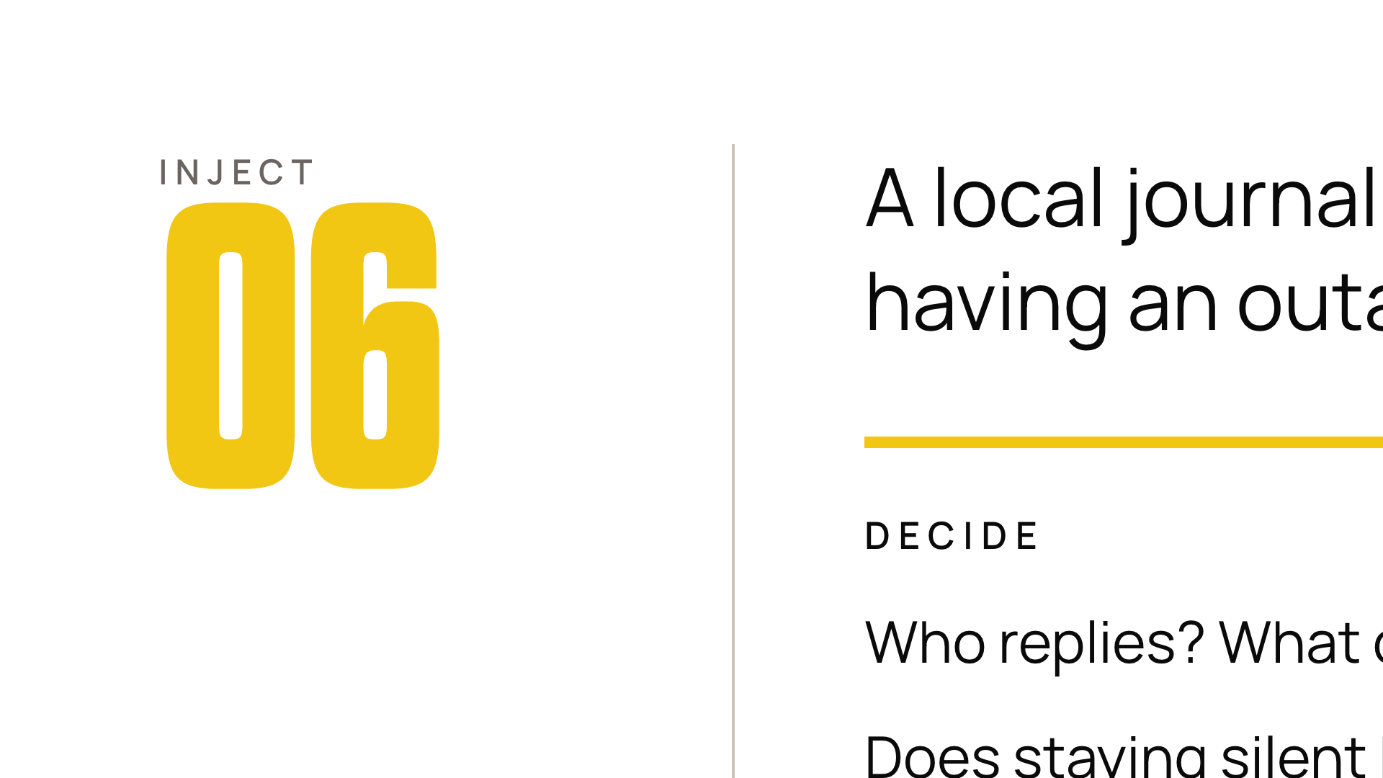
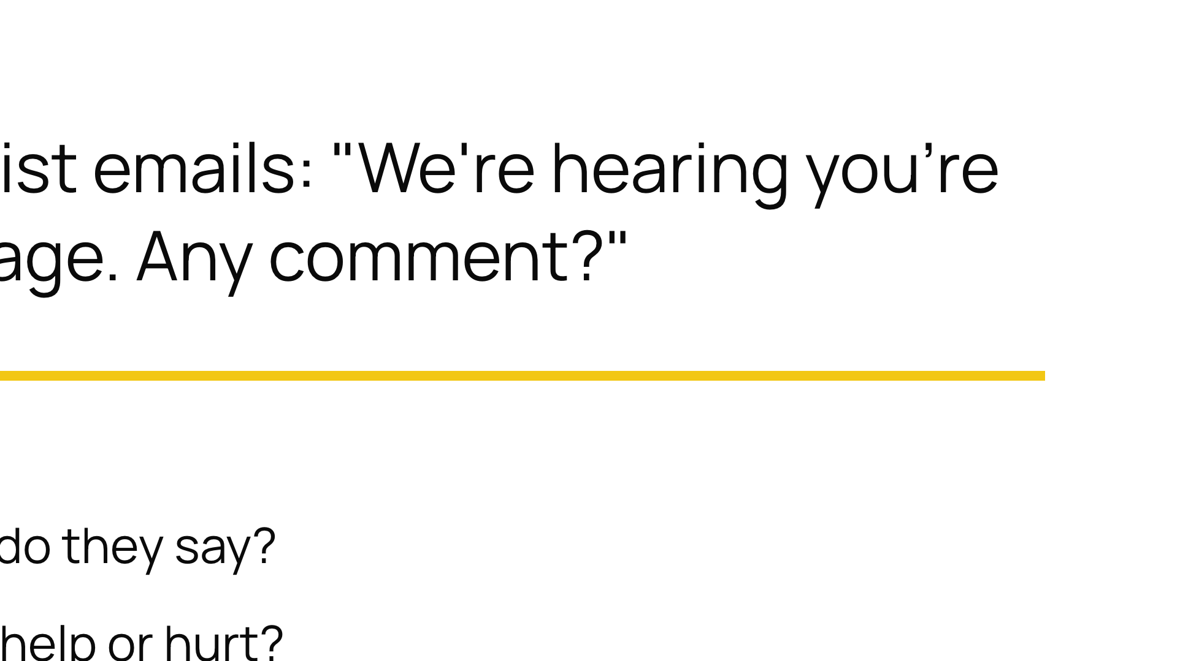


Notes:
Most rooms have no pre-agreed spokesperson. That absence is the finding.

Slide 10
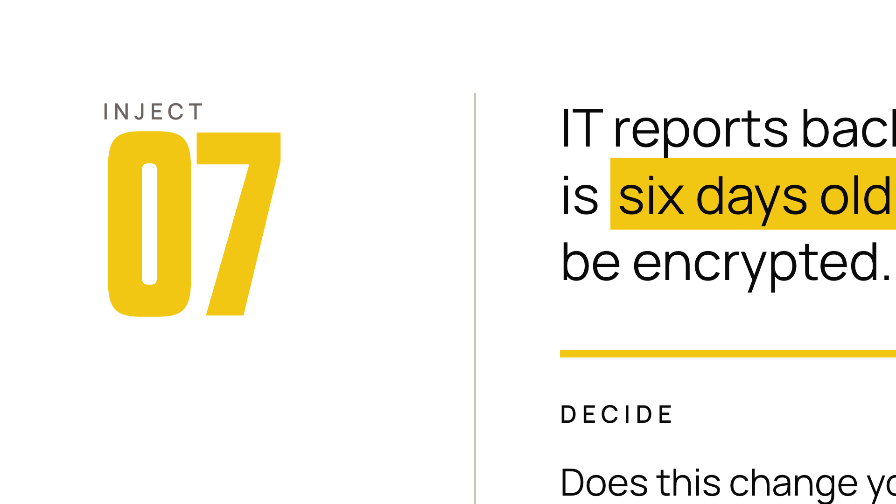
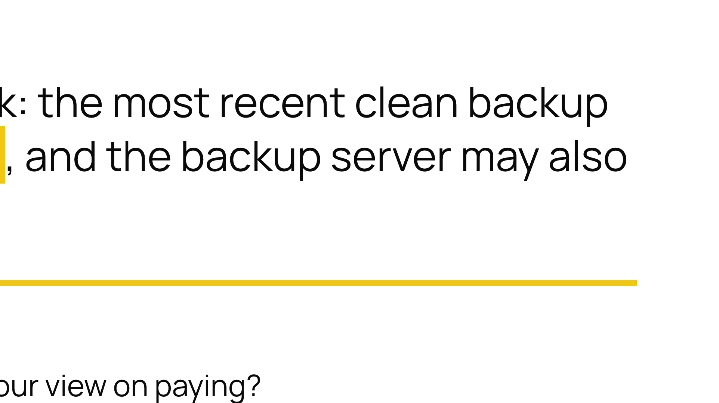

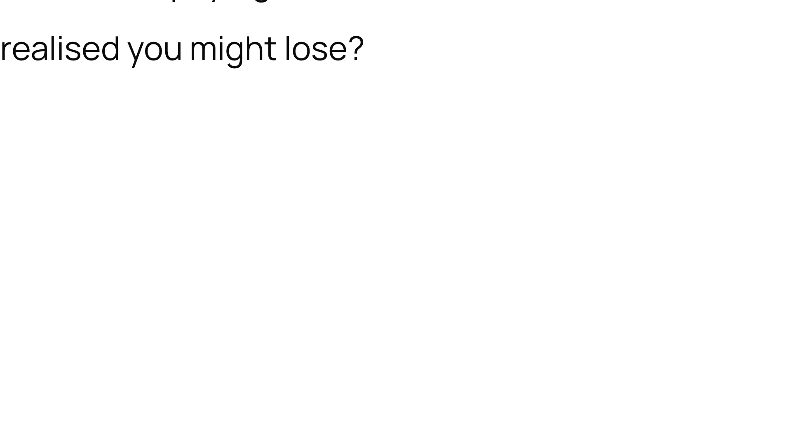
Notes:
This is where we will just restore from backup quietly dies. Let it land. Do not soften it.

Slide 11
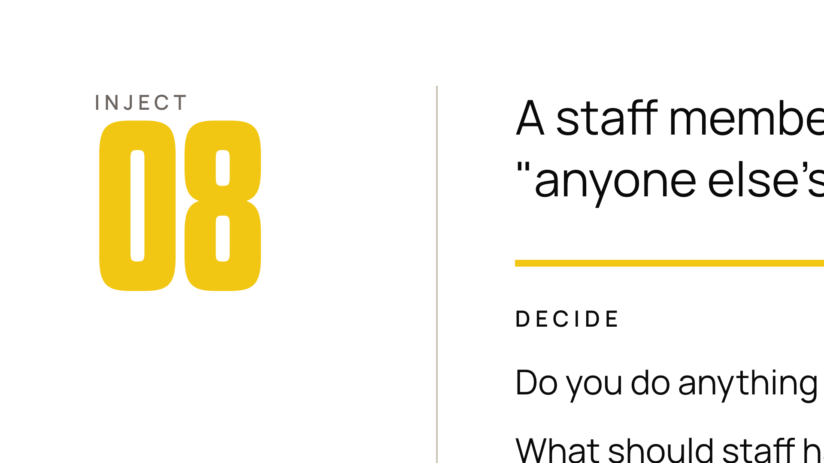
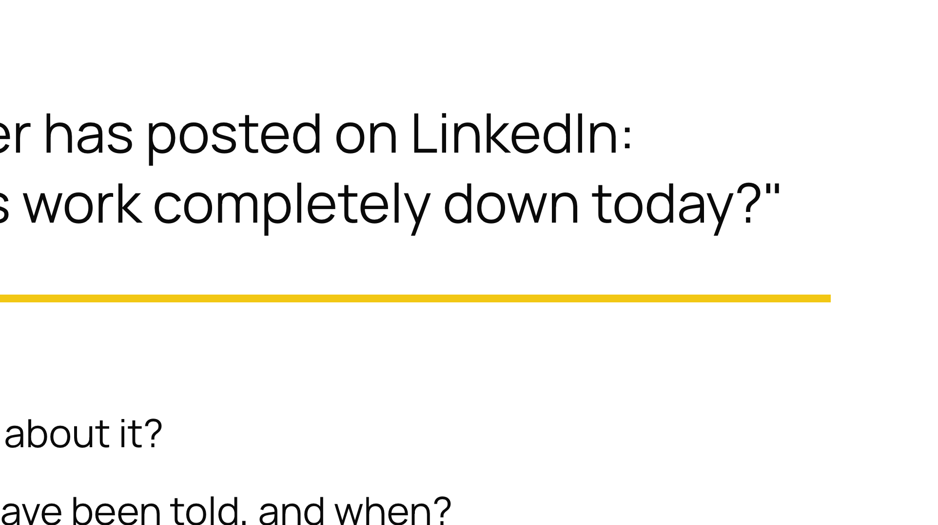


Notes:
Internal comms is a security control. Few teams treat it as one until this moment.

Slide 12
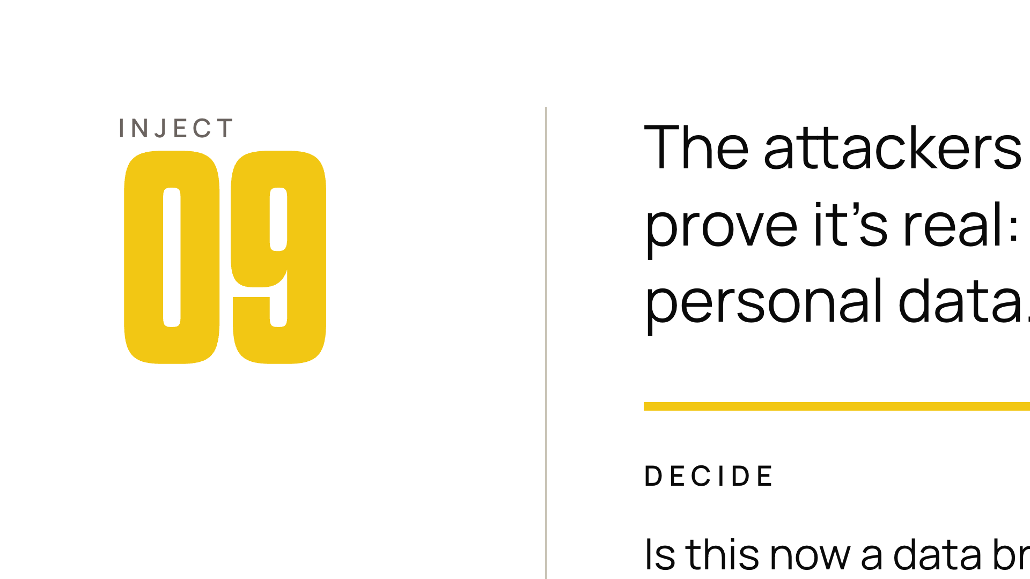
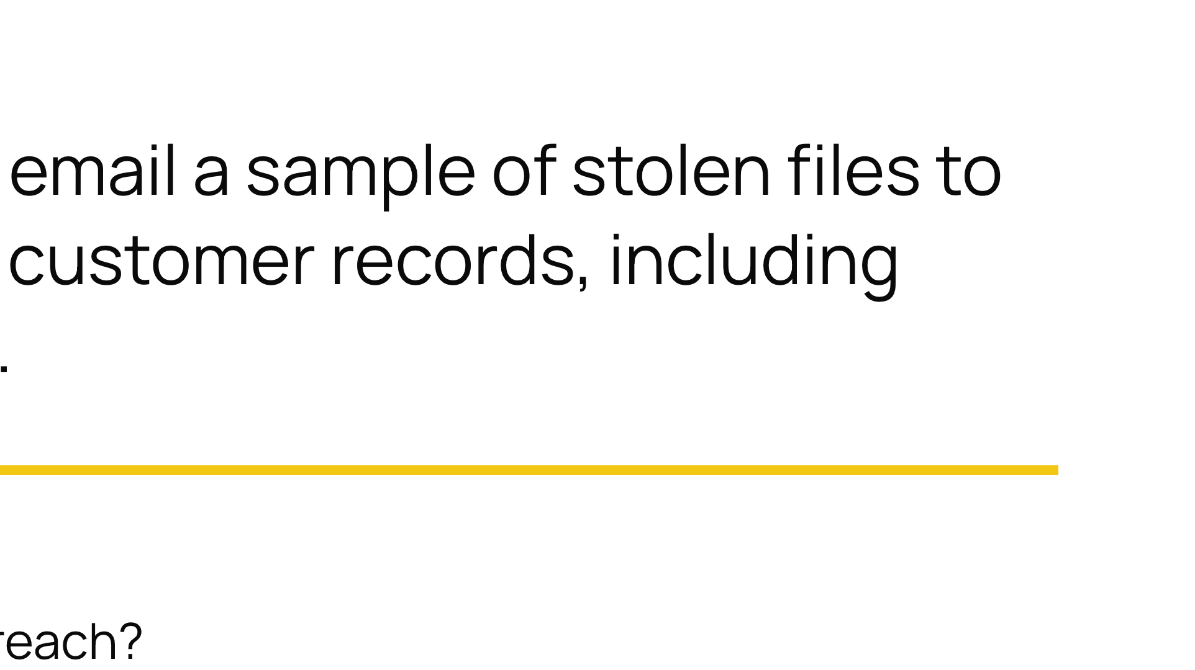


Notes:
Surface the regulator question (in the UK, ICO and 72 hours) even if nobody in the room knows the answer. Not knowing is the point.

Slide 13
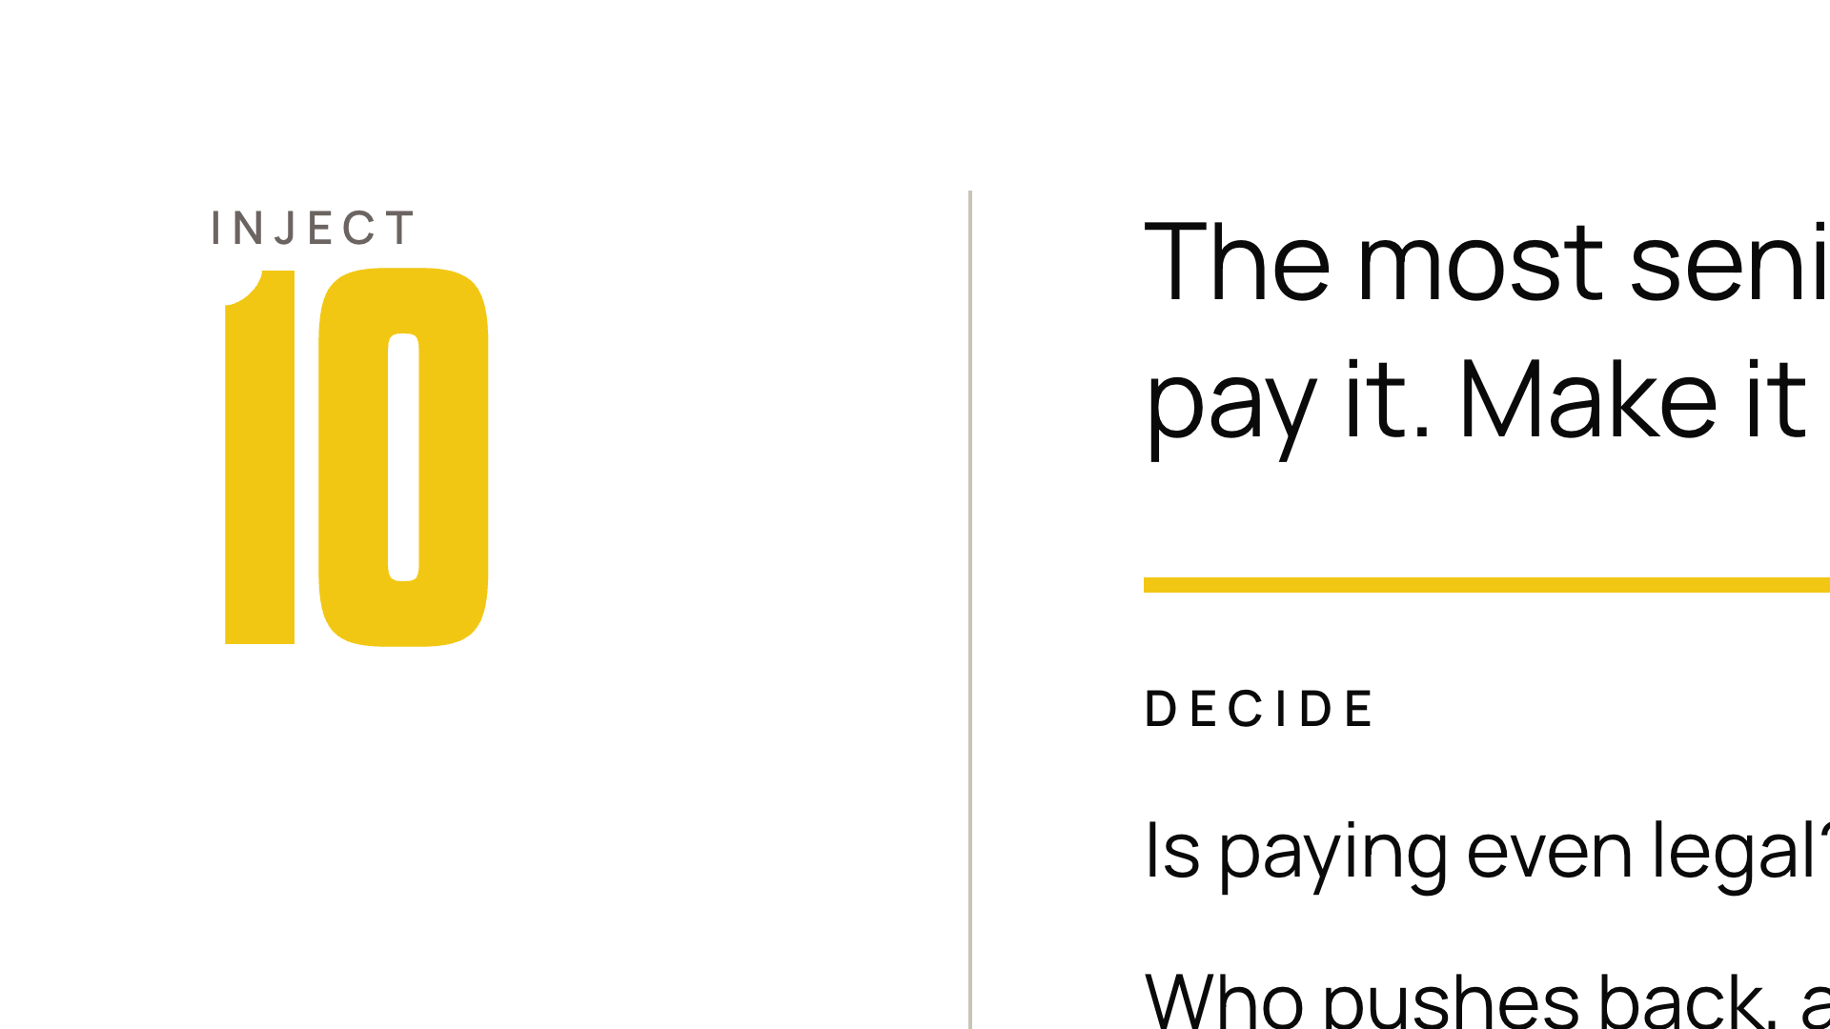
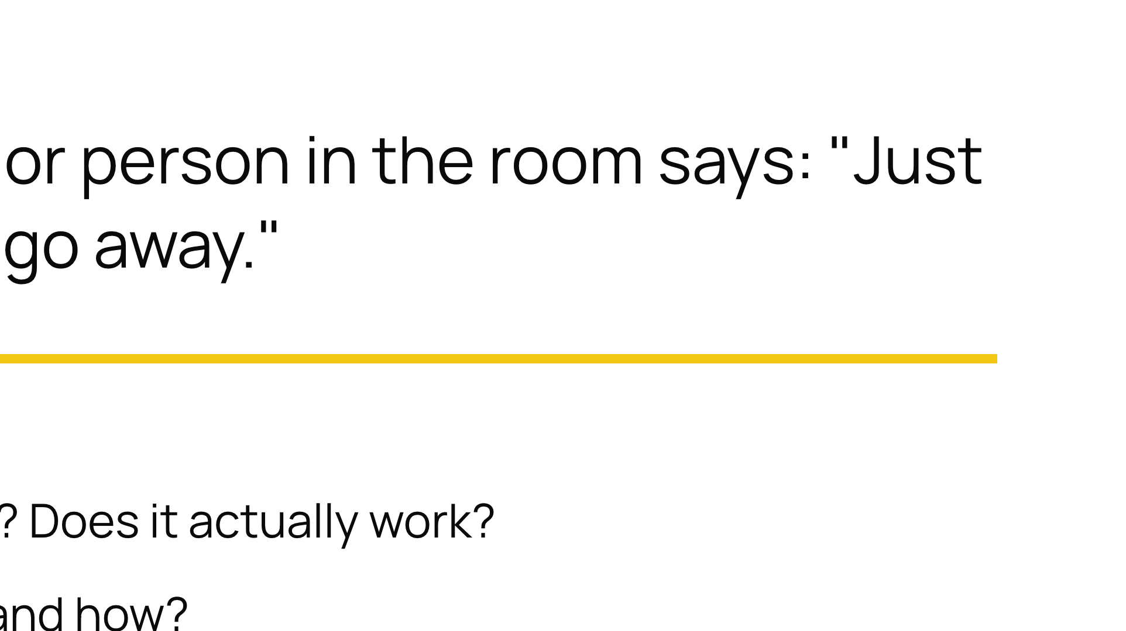


Notes:
No need to resolve it. The value is watching whether anyone can challenge the loudest voice under pressure.

Slide 14
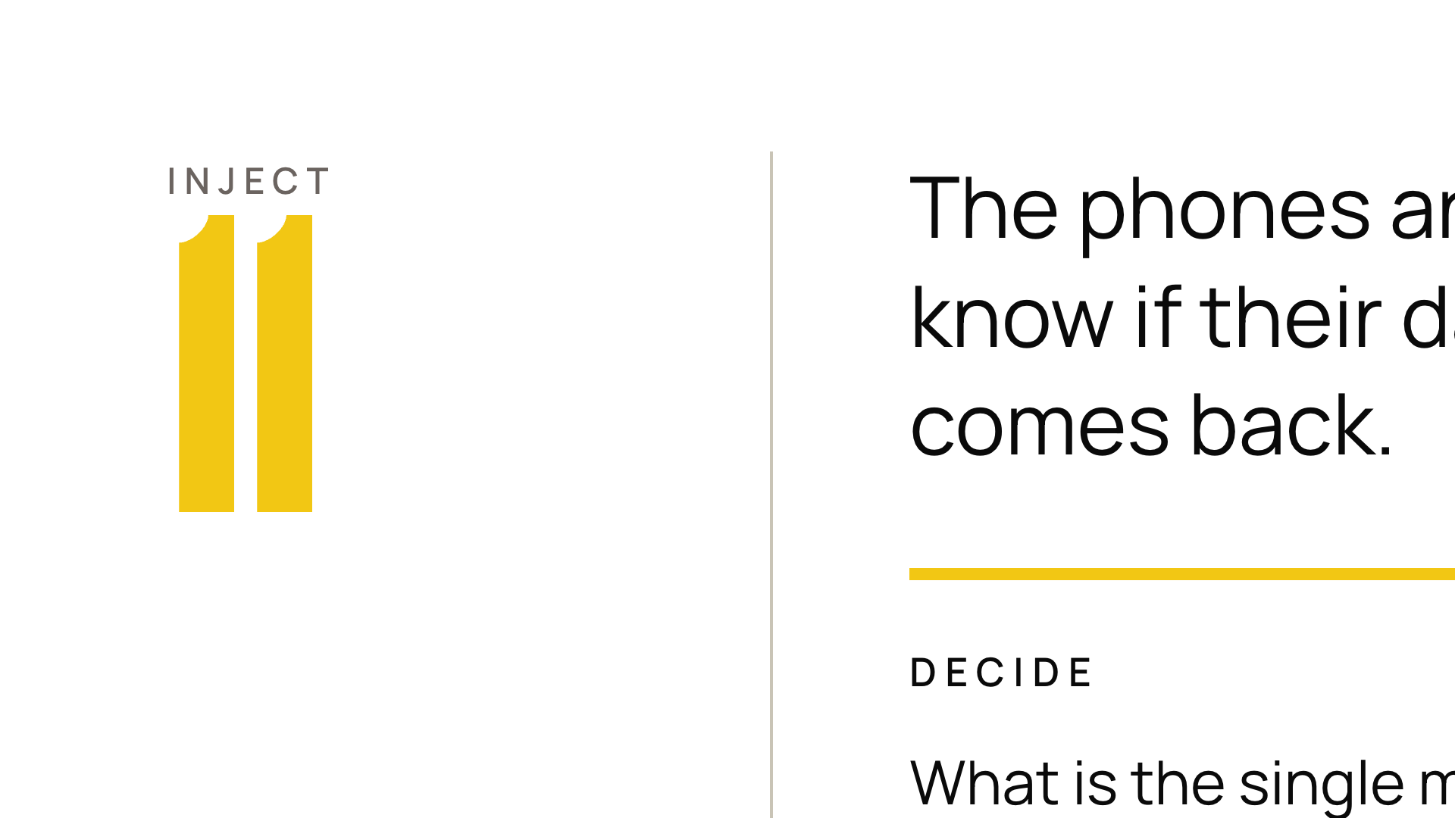
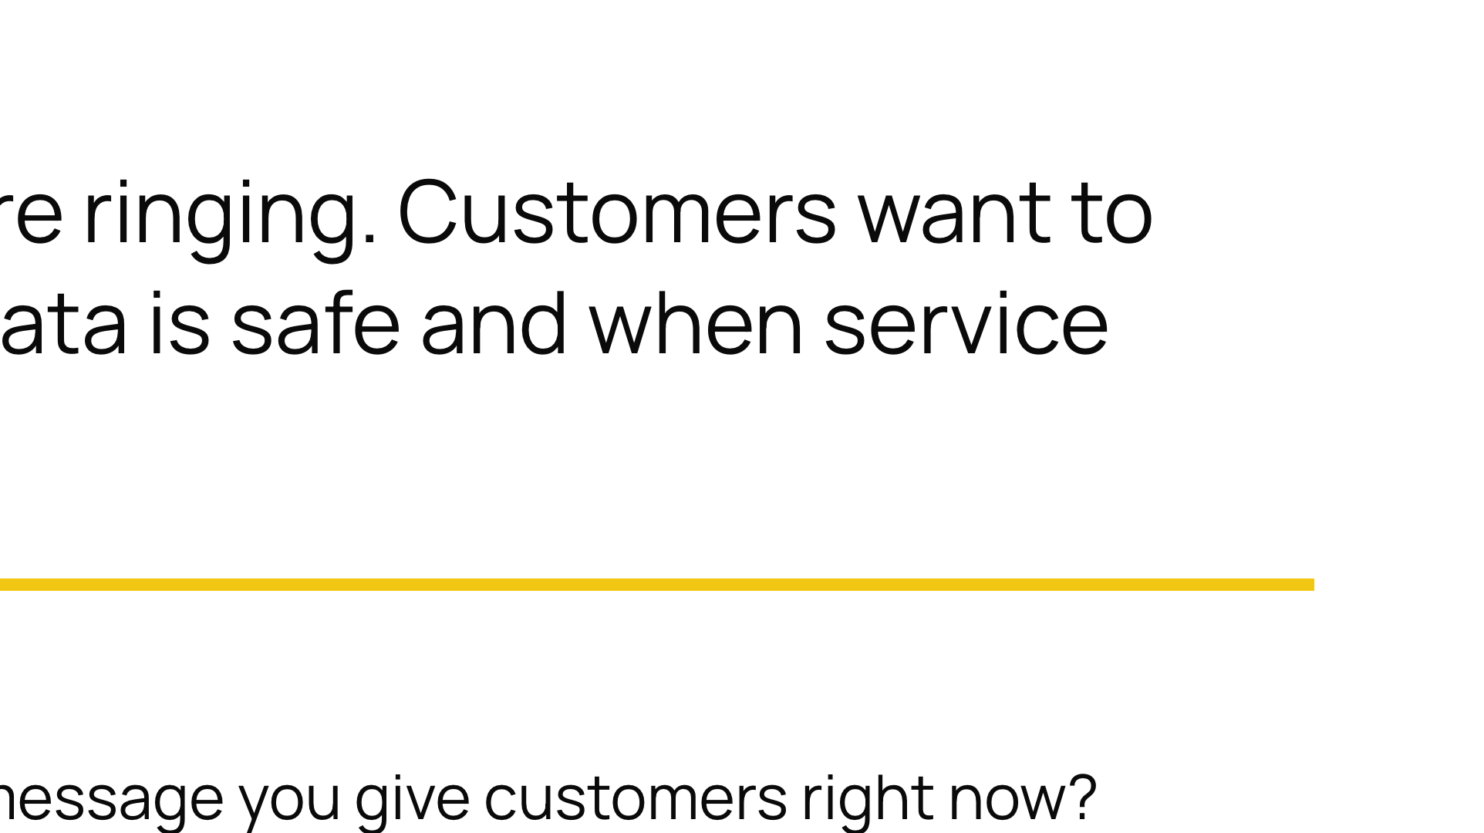
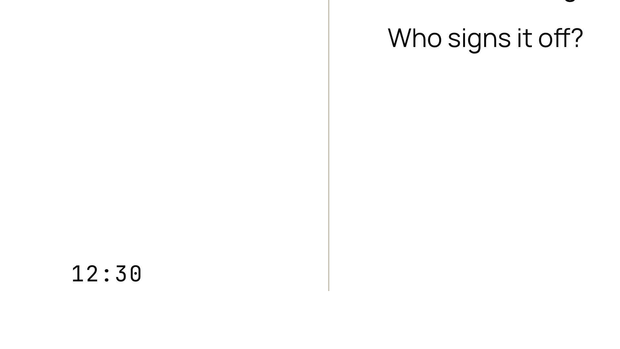

Notes:
Close the loop. The incident is now about reputation and trust, not just technology.

Slide 15




Notes:
Stop at the 50-minute mark wherever you are. Switch the room from playing the scenario to talking about themselves. Scribe fills in the three biggest gaps on the Decision Log as you go.

Slide 16
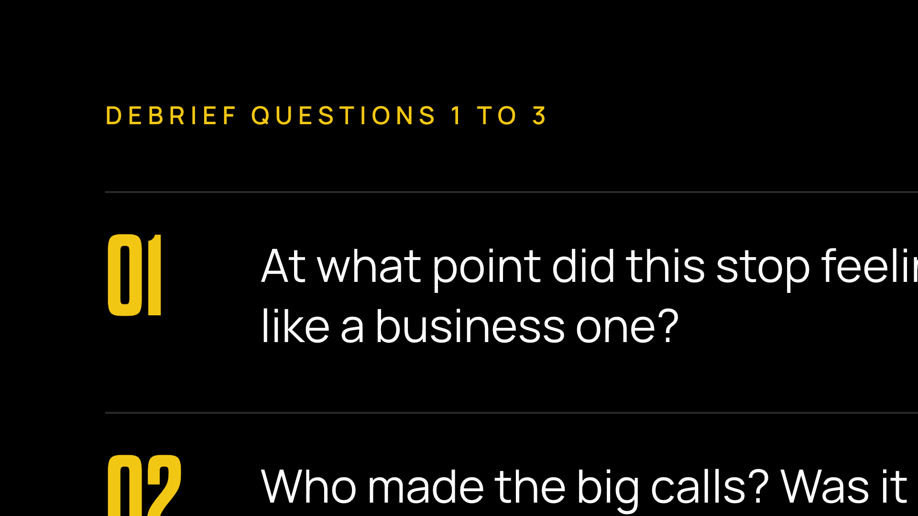
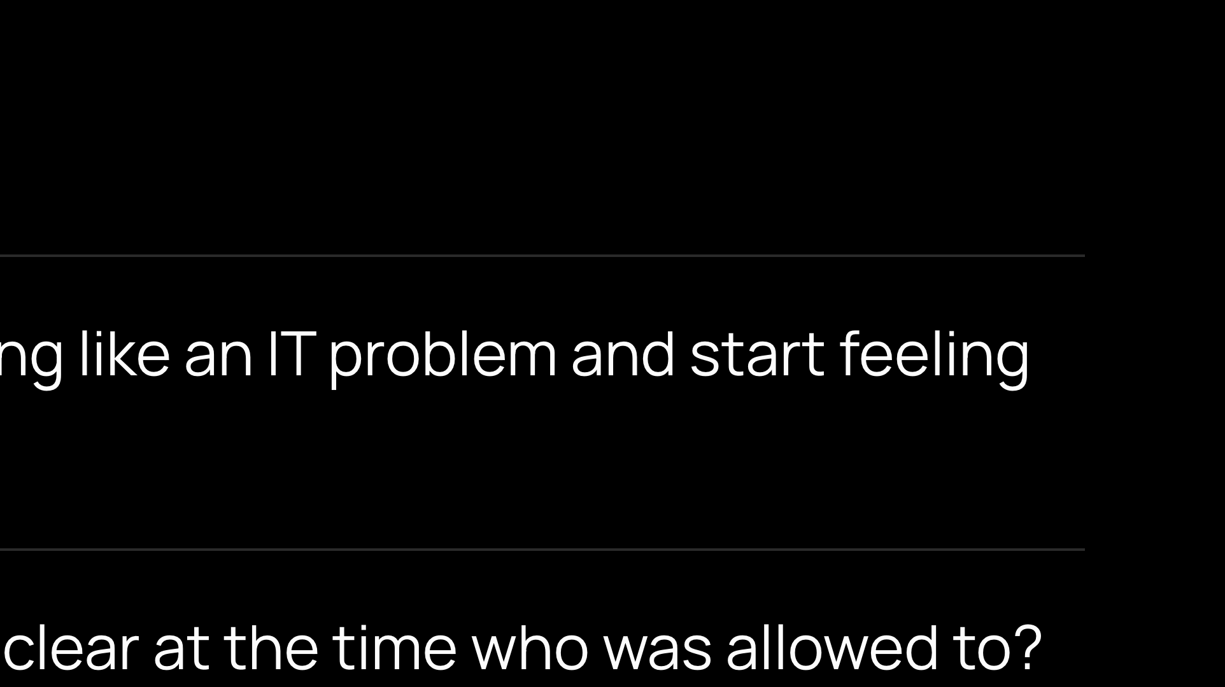
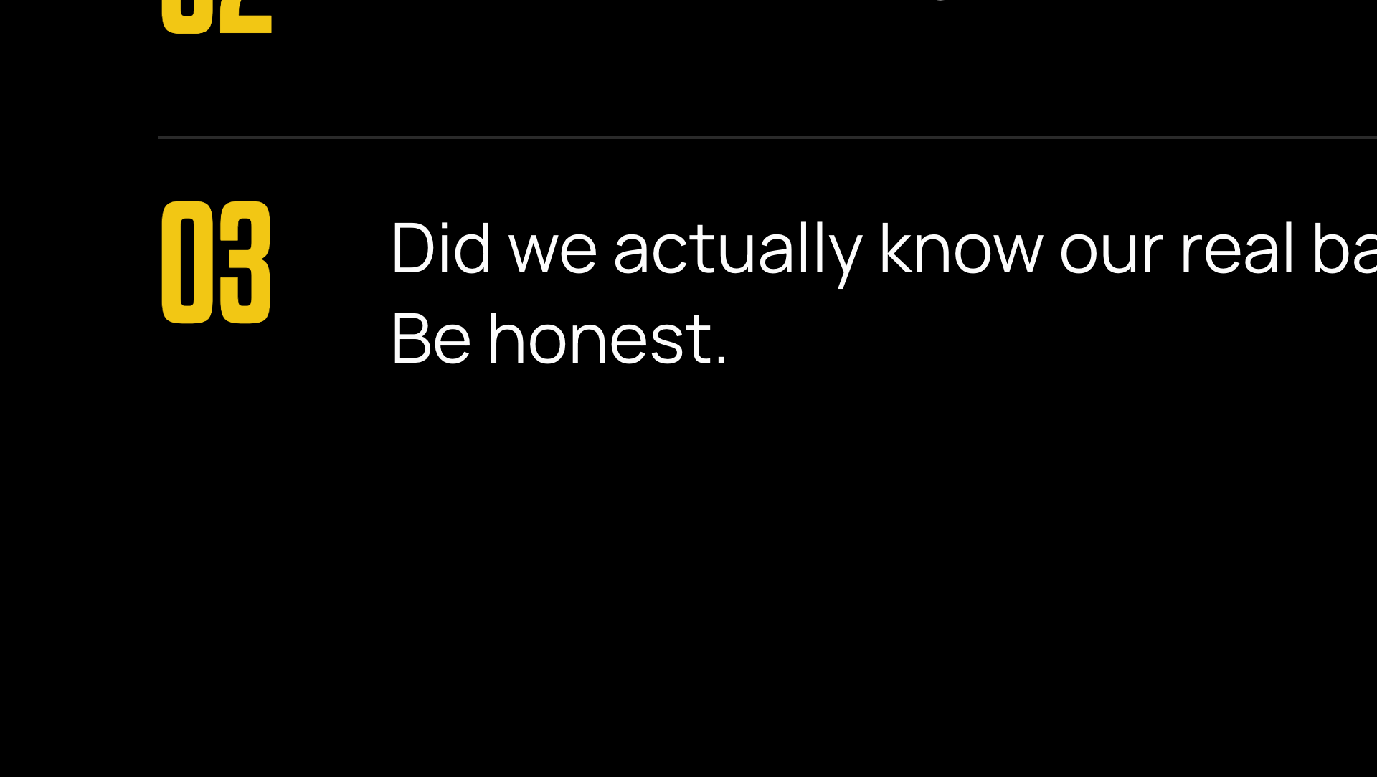
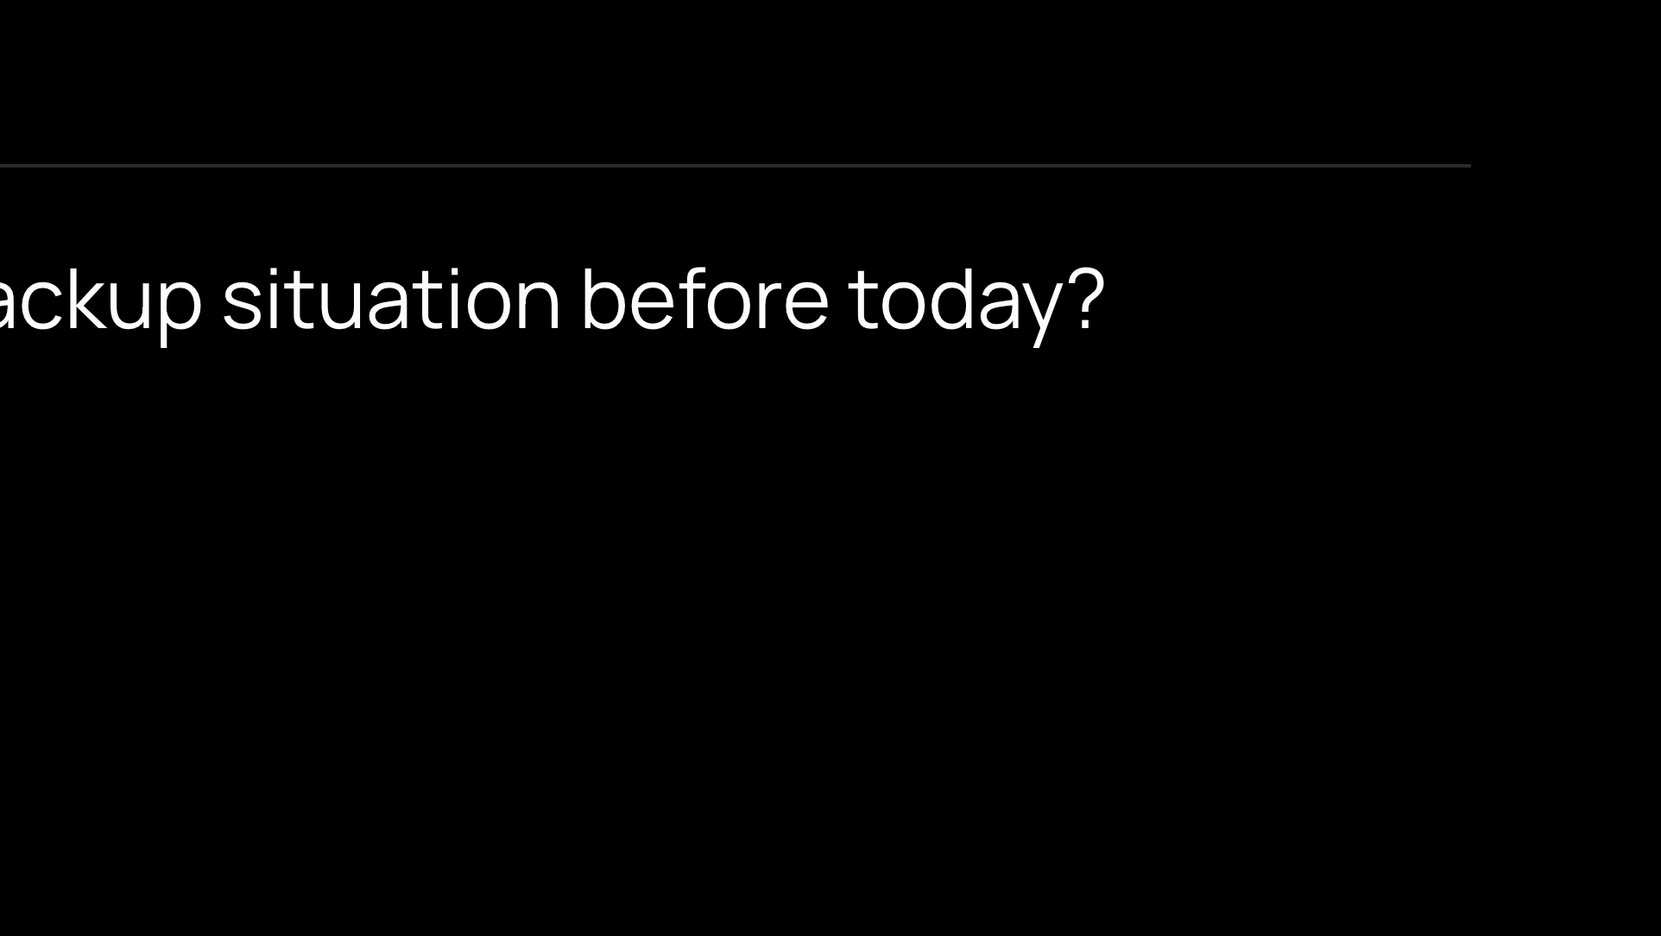
Notes:
Ask, then say nothing. The silence is doing the work. Question 3 is the one people dodge. Hold it until someone says what the backup situation actually is.

Slide 17
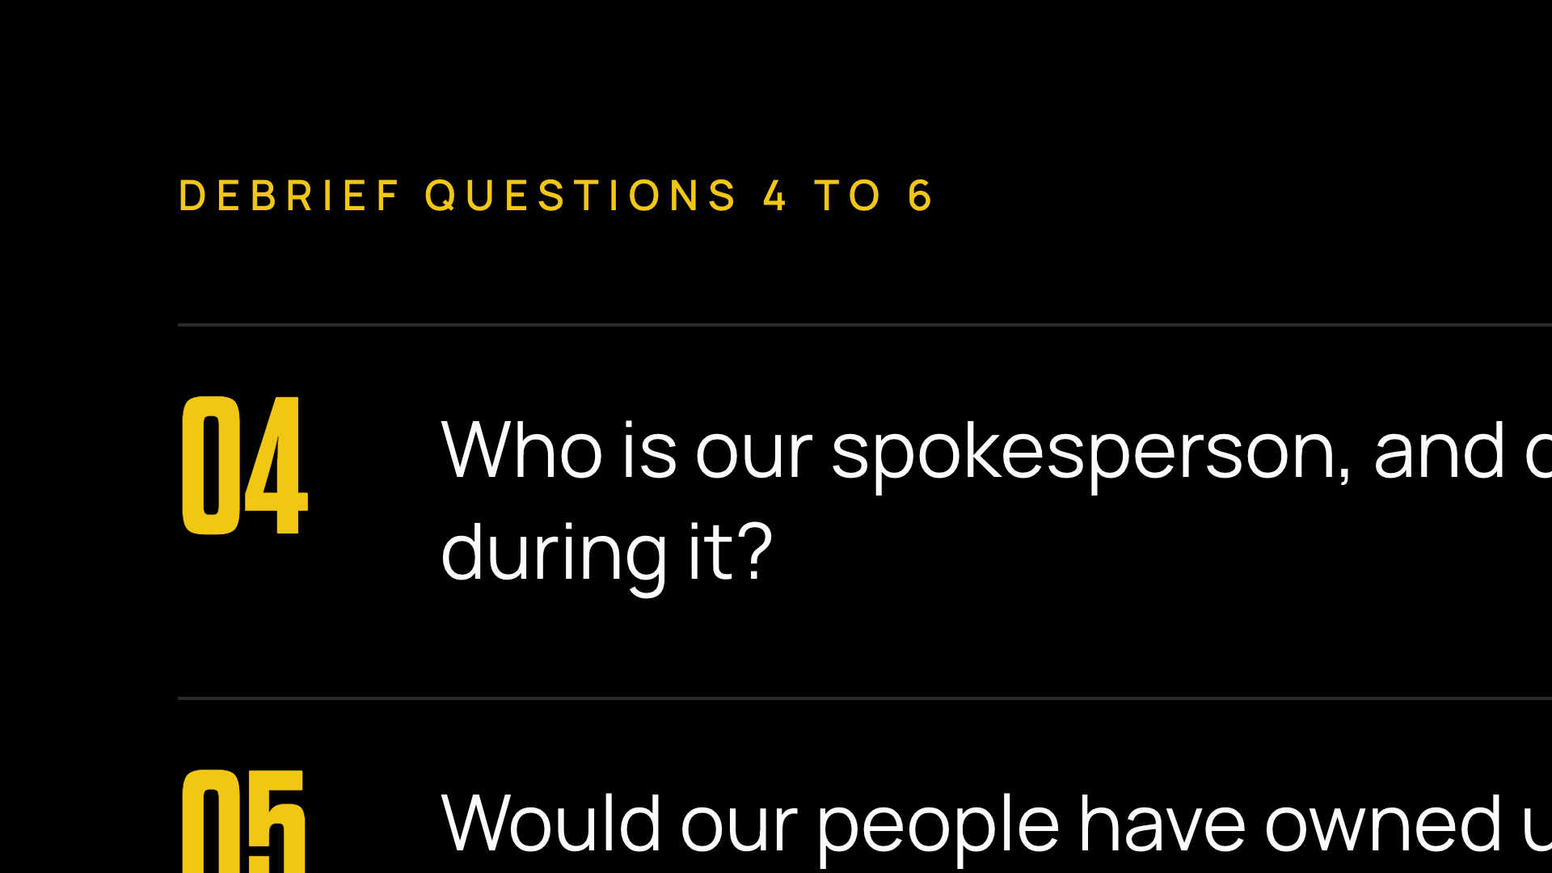
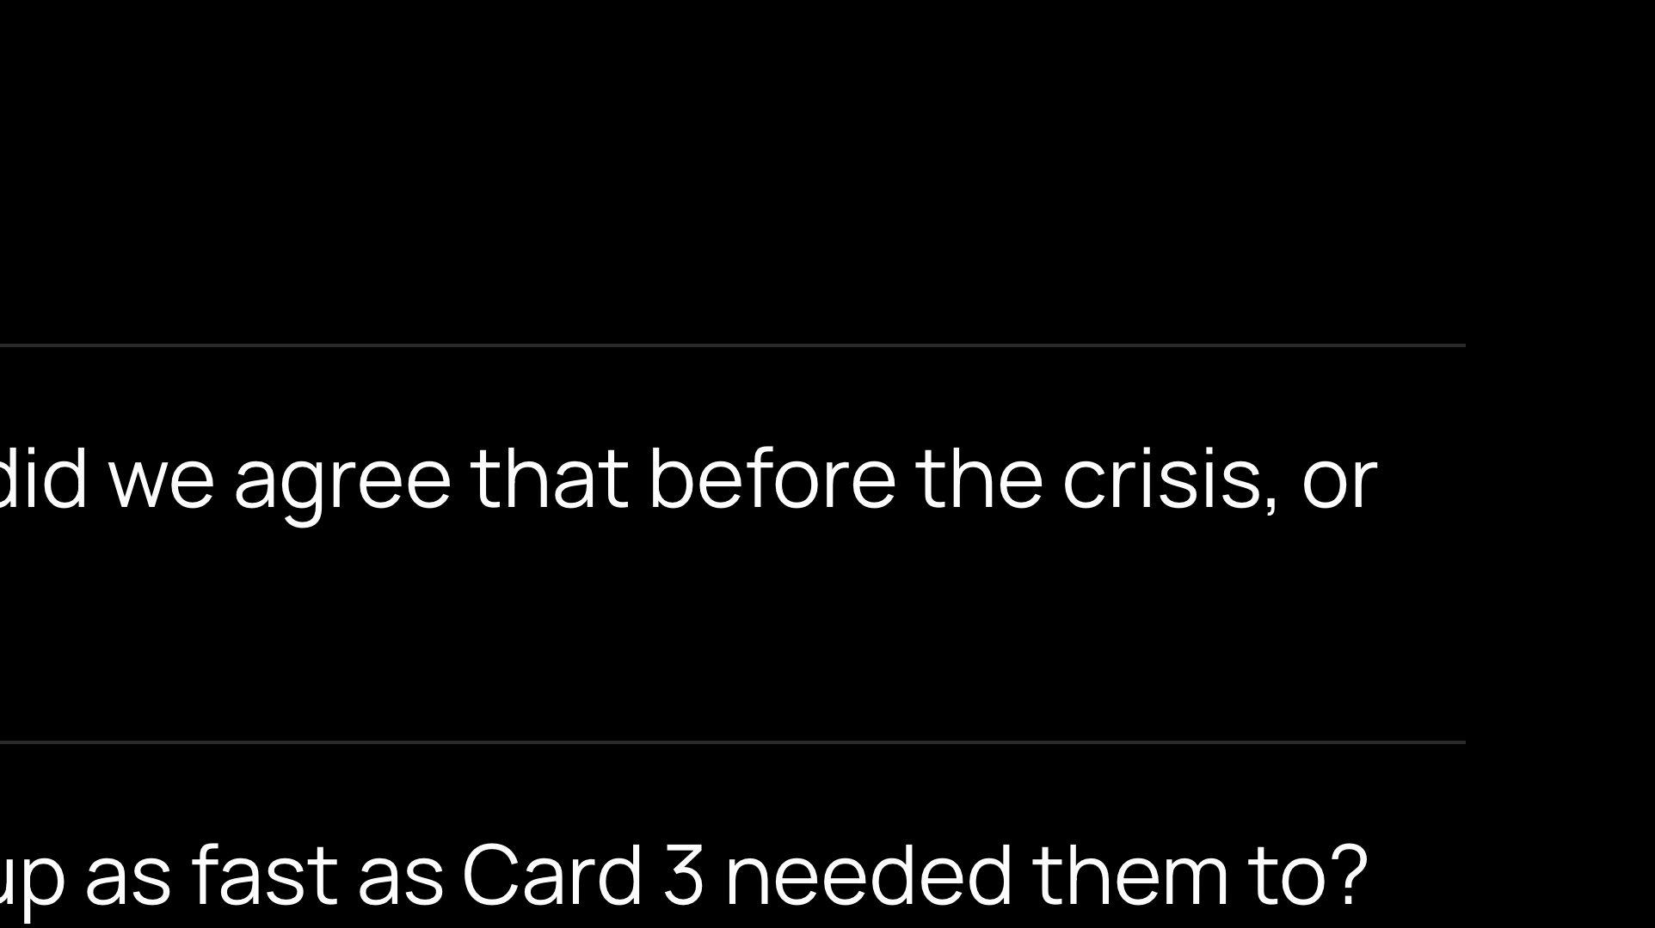
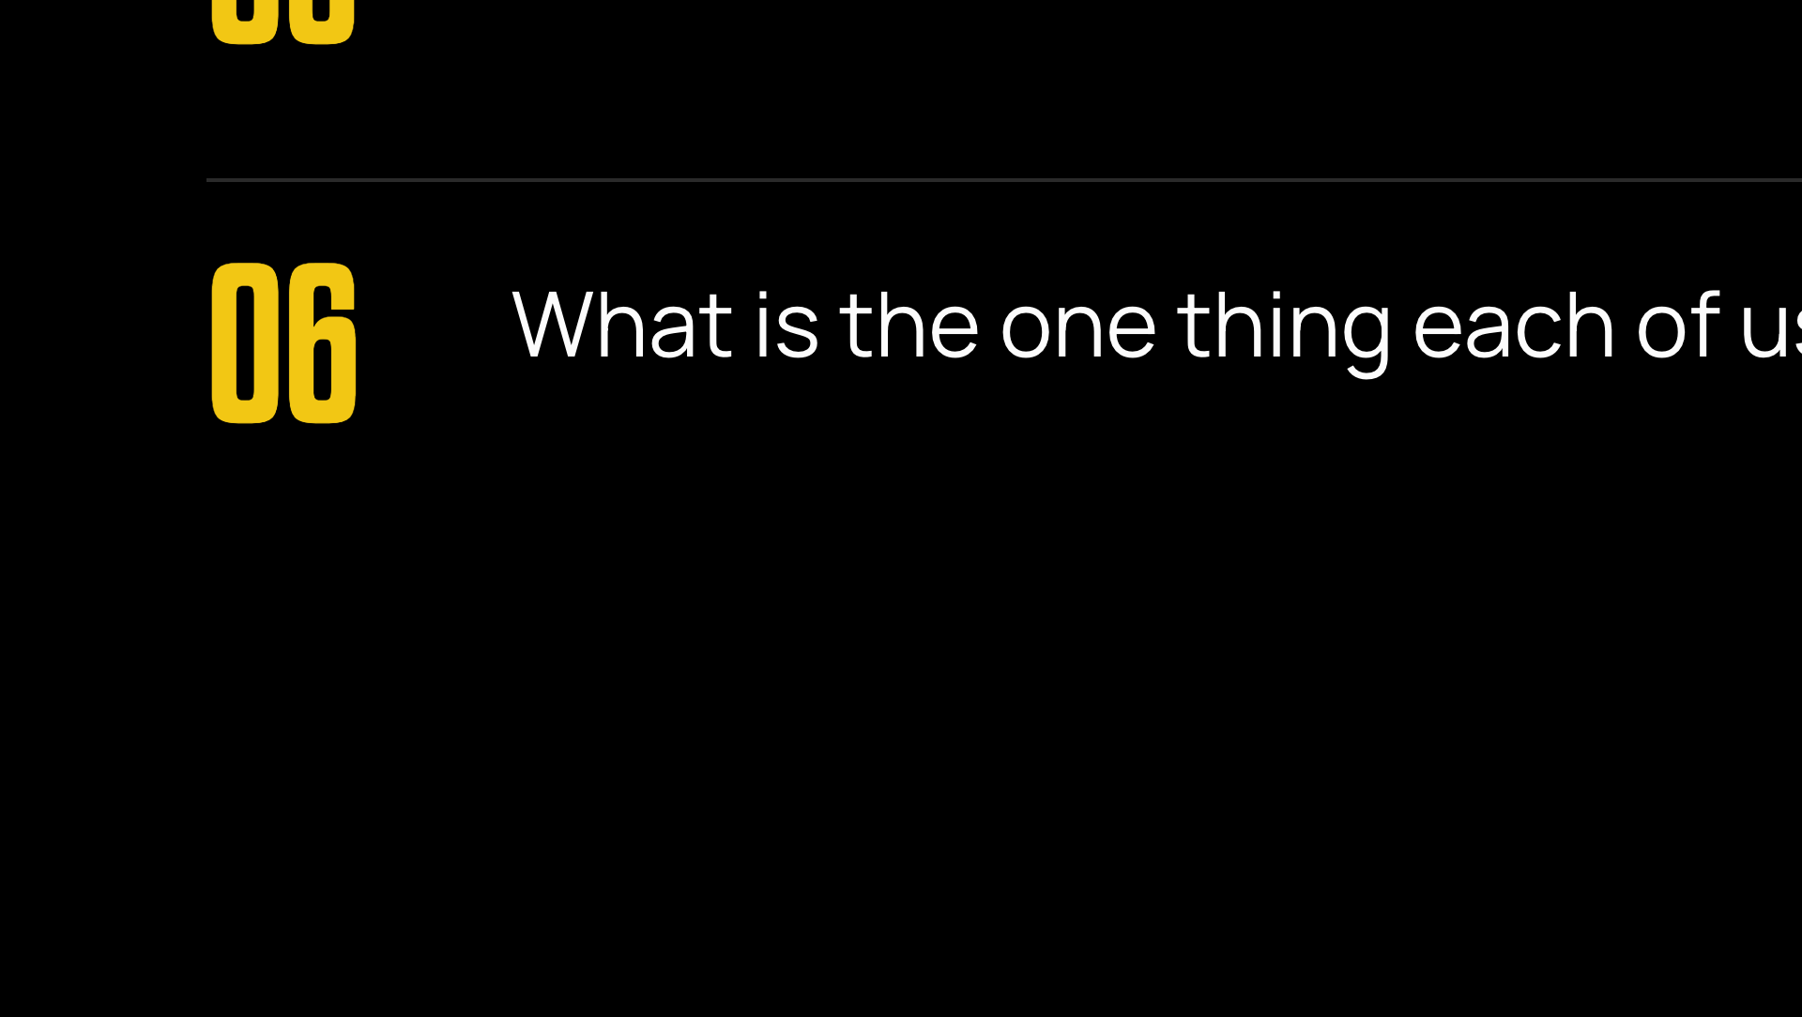
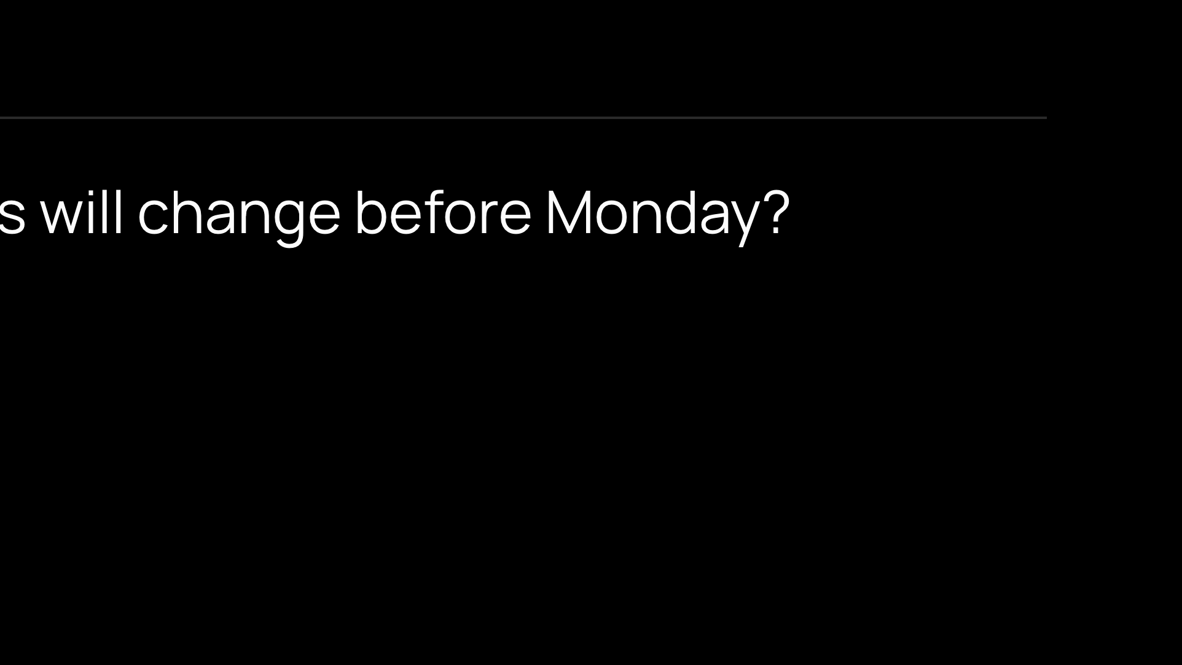
Notes:
Question 6 is the only one everybody has to answer out loud. Go round the table. The Scribe writes each commitment down. That is what goes in the follow-up email.

Slide 18
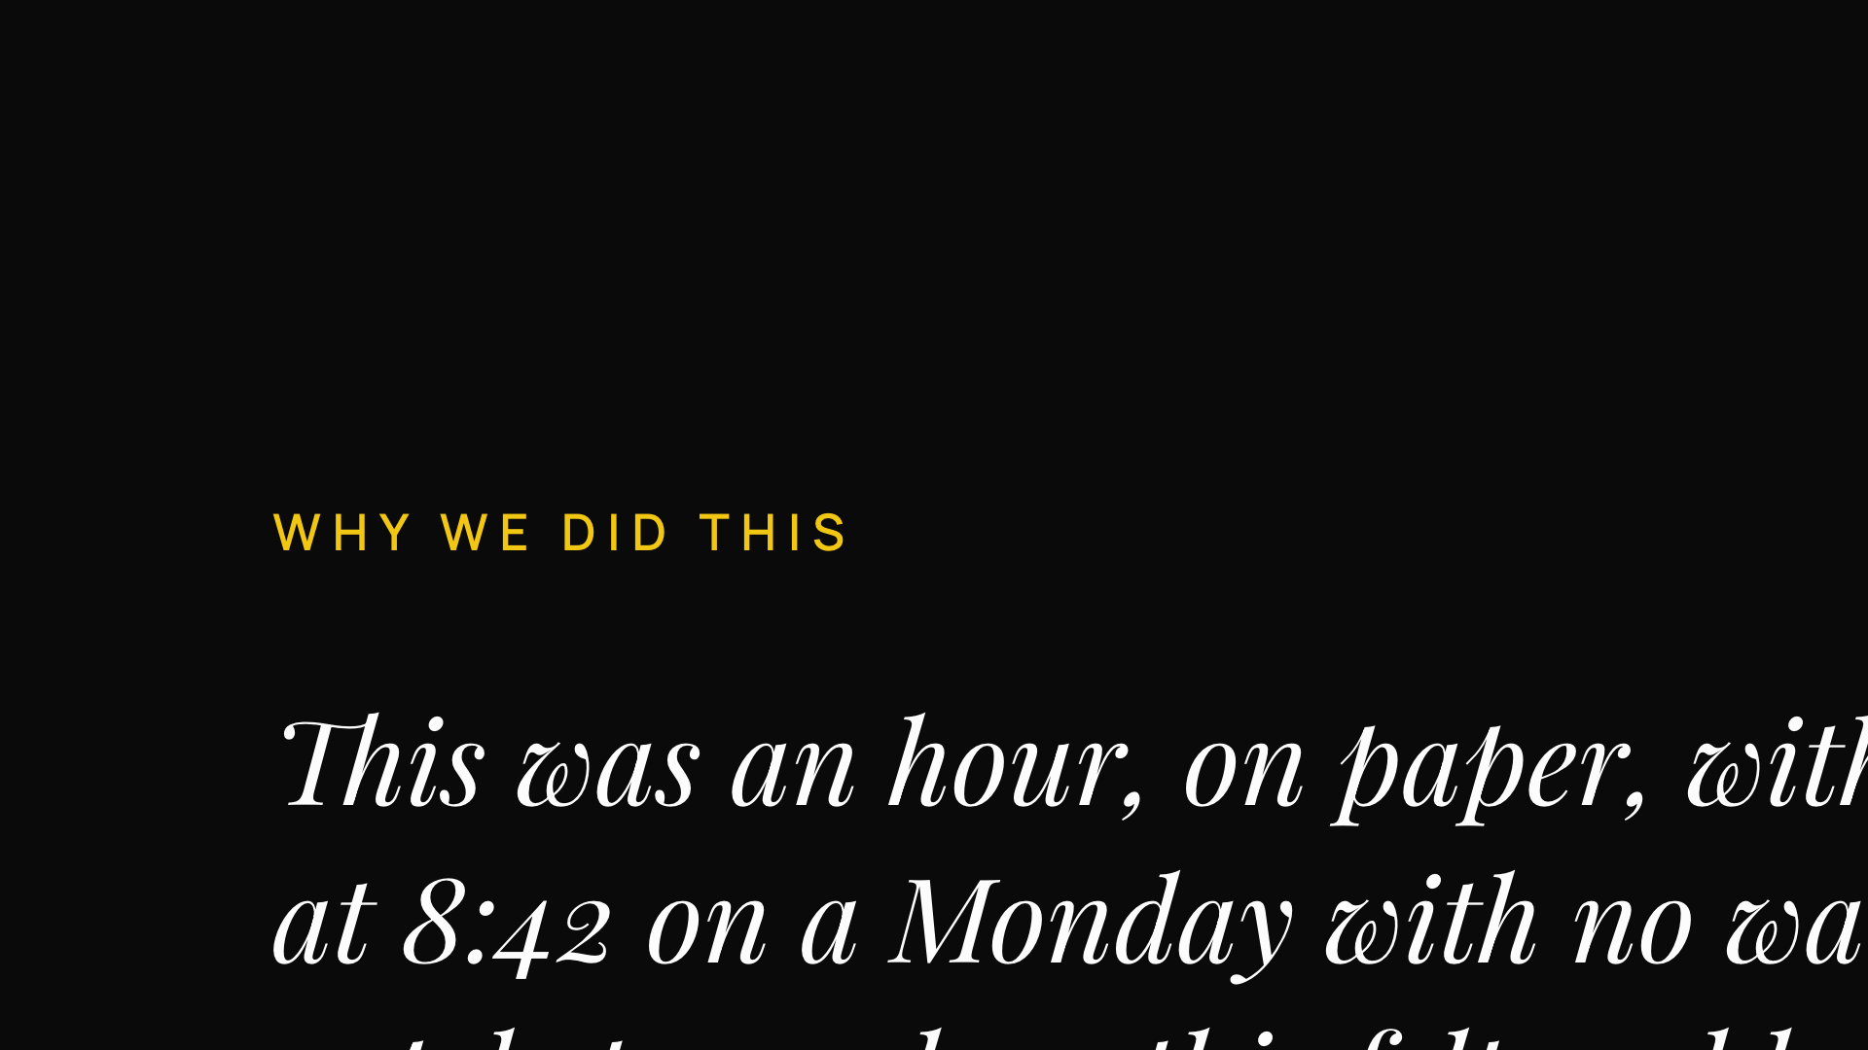
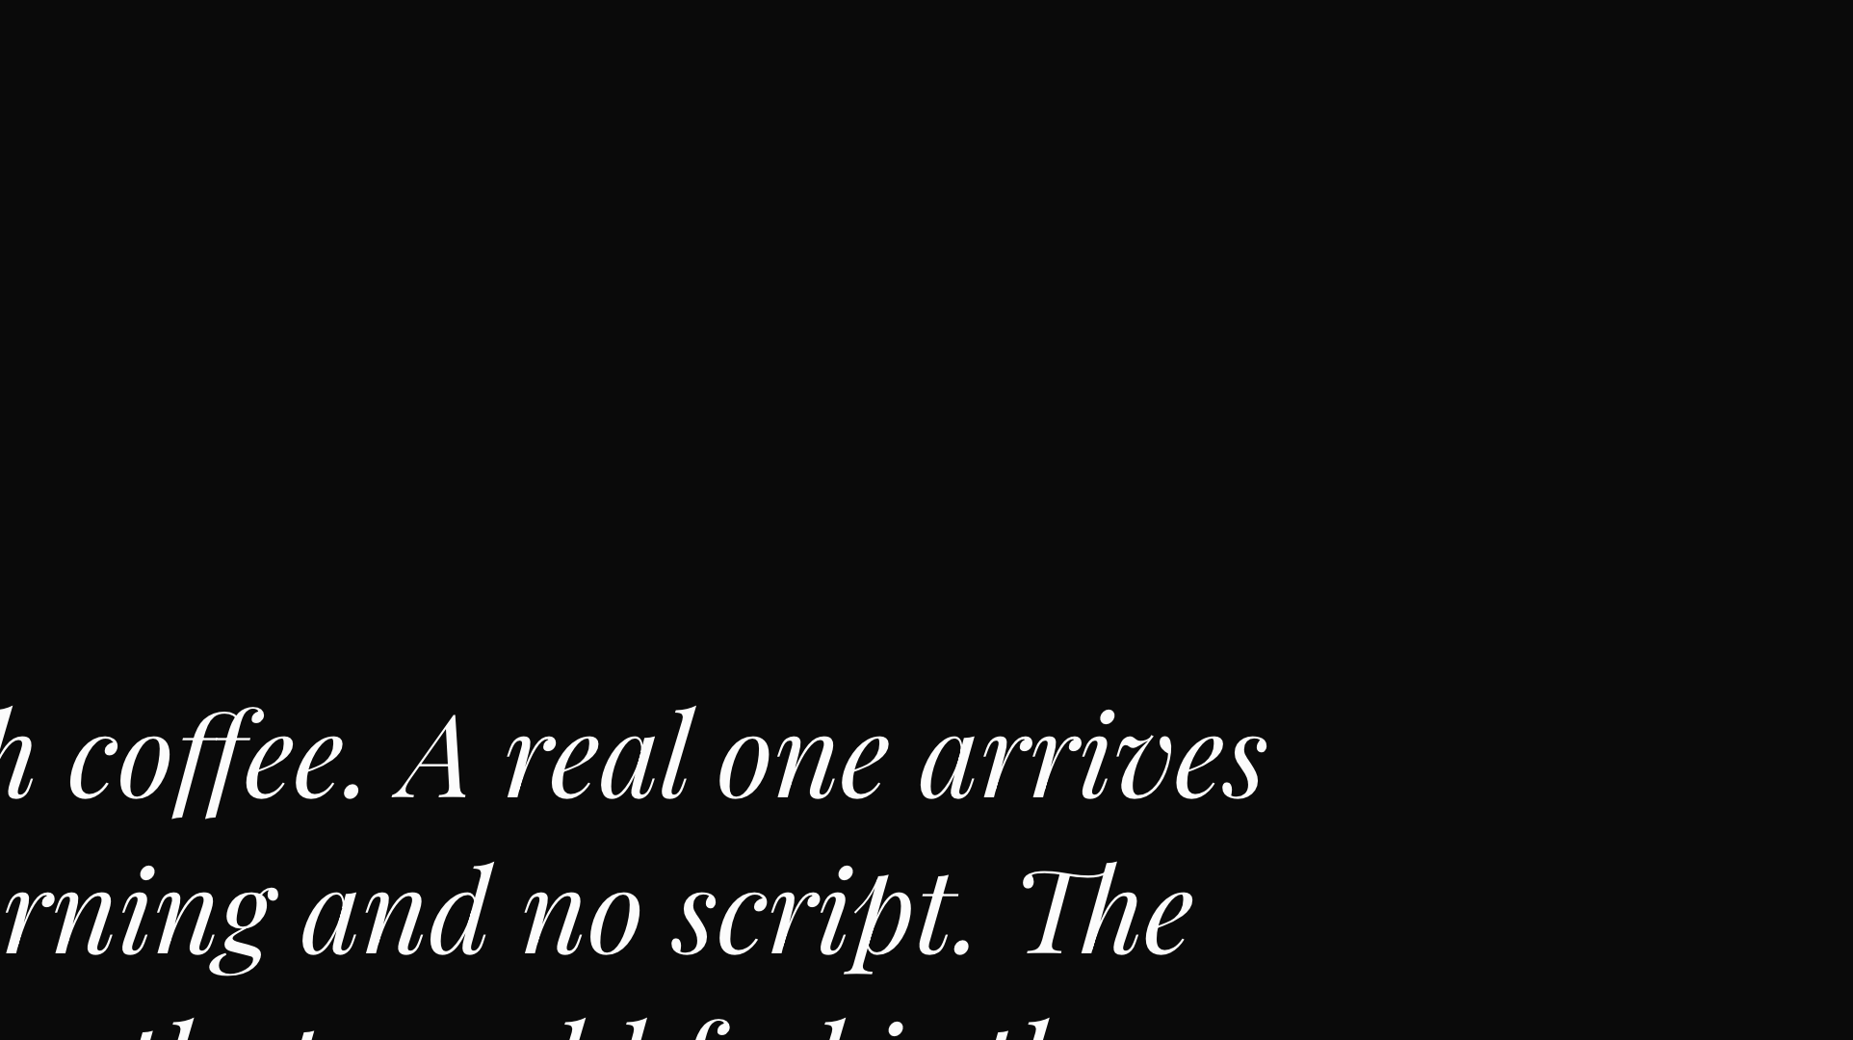


Notes:
Read this one exactly as written, then stop talking. Do not add anything after it.

Slide 19




Notes:
Only if the room is warm to it. Say the one line: you controlled the clock today, and nobody's phone was actually ringing. Then hand out the Decision Log.

